Slide 1
Connecting Language to the World
CSCI 601-471/671 (NLP: Self-Supervised Models)
https://self-supervised.cs.jhu.edu/sp2024/

Slide 2
Transformers for Speech and Audio

Slide 3
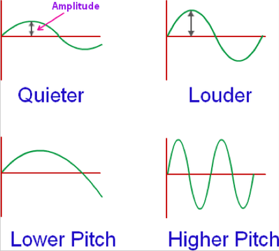
Dealing with Audio Data
Audio is originally continuous wave.

Slide 4
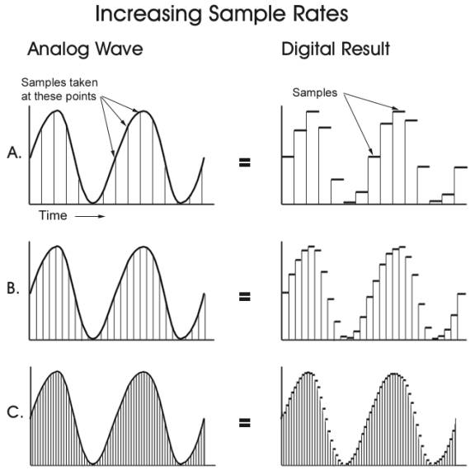
Dealing with Audio Data
Audio is originally continuous wave.
When recording it, we sample from it.
The choice of sampling rate determines the fidelity of the recording.
If the sampling rate is too low, the digital sound will be muffled.
Nyquist limit: the minimum rate.

Slide 5
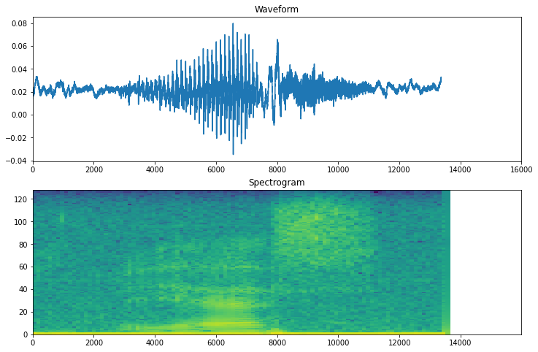
Spectrogram
A spectrogram shows the frequency content (y-axis) of an audio signal as it changes over time.
In spectrogram, magnitude of the sound is shown by color-coding.
https://huggingface.co/learn/audio-course/en/chapter1/audio_data

Slide 6
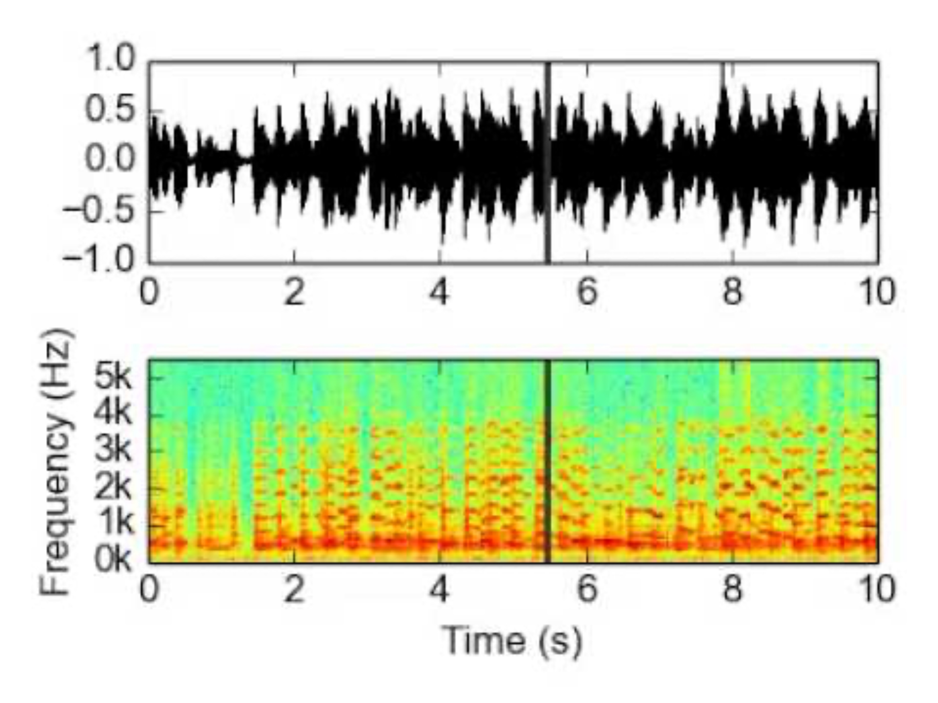
Spectrogram: Example
https://huggingface.co/learn/audio-course/en/chapter1/audio_data

Slide 7
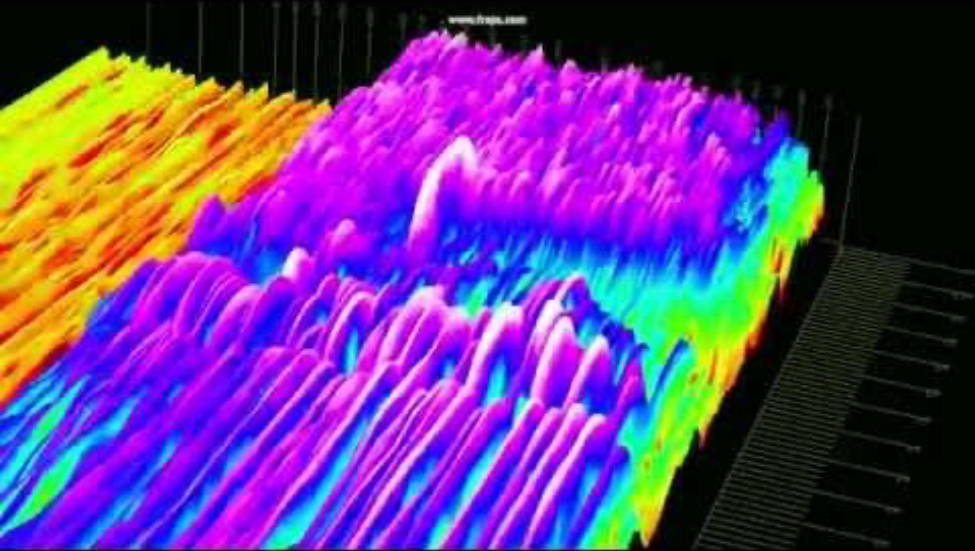
Spectrogram: Example
https://huggingface.co/learn/audio-course/en/chapter1/audio_data

Slide 8
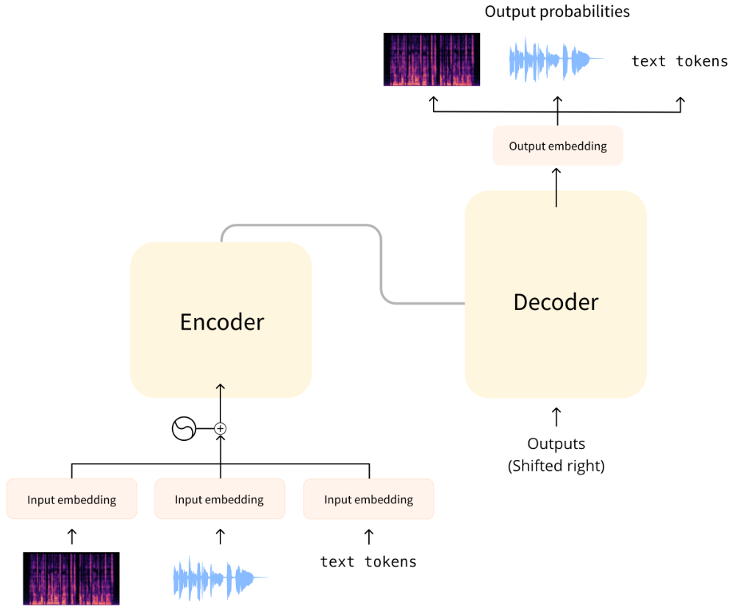
Feeding Speech to Transformer
Turn your data into a format that can be processed by Transformer.

Slide 9
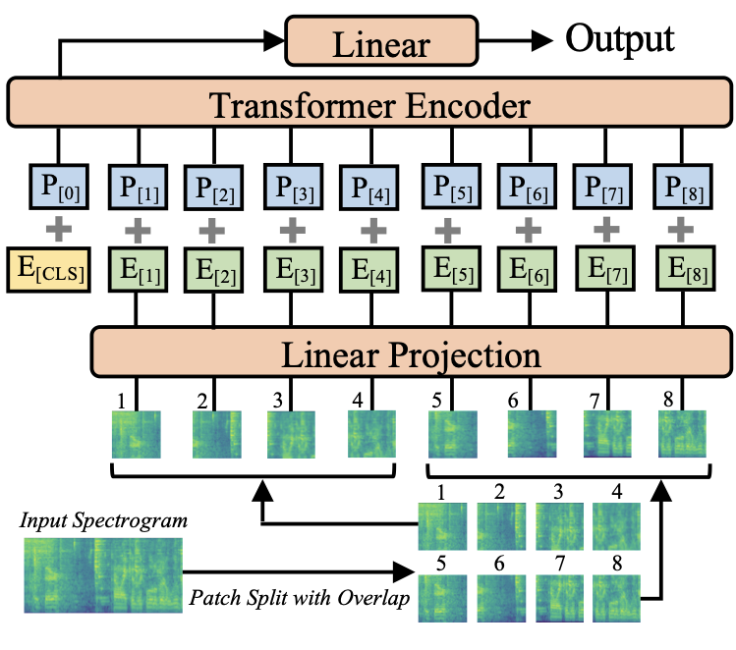
Audio Spectrogram Transformer (AST)
Like ViT, AST splits the spectrogram into a sequence of partially overlapping 16×16 images.
This sequence of patches is then projected into a sequence of embeddings, and these are given to the transformer encoder.
On top of this is a simple classification layer with sigmoid activation to map the hidden-states to classification probabilities.
AST: Audio Spectrogram Transformer, 2021

Slide 10
Birds of View of Speech Tasks
The progress in speech/audio is not as mature as areas.
There are various modality connections:
Speech/audio to text, Speech/audio to image, Text to speech/audio, Image to speech/audio, …
Recording audio is quite tricky:
Each microphone is different
Each room is different
Multiple audio sources (e.g., group of people)
…
There are tons of sounds in the world that are not easily captured.

Slide 11
Summary
Audio/speech via Transformers?
Use the same old recipe: pre-process and feed it directly.
How far are we from solving it? Quite far!!

Slide 12
LMs and Code Generation

Slide 13

How many people have used Github CoPilot?
https://github.com/features/copilot

Slide 14

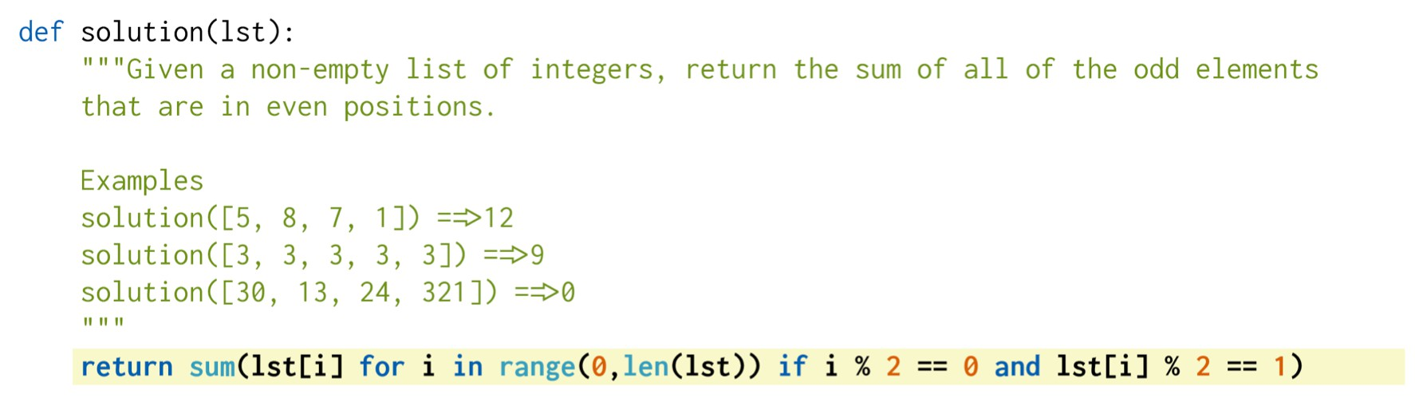

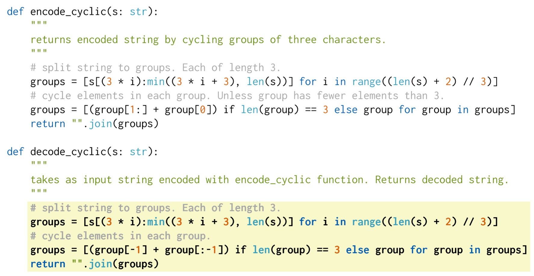
Some examples
Evaluating Large Language Models Trained on Code, 2021

Slide 15
General Idea
The story is the same as what we have seen before! 😮
1. Pre-train on web-scale text/code data (what we have seen before)
2. More pre-training on a lot of [potentially, noisy] code data (new)
3. Fine-tune on smaller but cleaner data (new)
Evaluating Large Language Models Trained on Code, 2021

Slide 16
Setup: Pre-train on Code Data
Start with GPT-3 that is already pre-trained to on text and code.
Codex: Starting from GPT-3, do continued training on code data.
Training data: 160GB of Python code (unlabeled!!)
The goal is to evaluate model for:
Generating code from doc-string (implementing an idea)
Generating doc-string from code (explaining code)
Why should this work?
Human written code often comes with comments (i.e., free supervision)!! 😍
Evaluating Large Language Models Trained on Code, 2021

Slide 17
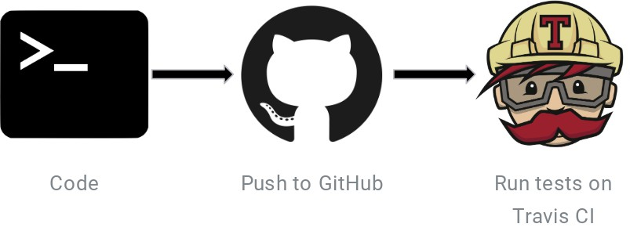
Fine-tuning on Clean[er] Data
Competitive Programming (10,000 problems)
Problem descriptions as docstrings
These have unit test coverage
Continuous Integration (40,000 functions)
“Developers regularly merge code changes into a central repository, after which automated builds and tests are run.”
These come with free test functions.
They also do additional filtering.
Filter out:
Low-quality docstring
Stateful functions that may be missing variables outside them.
Approach:
Use Codex-12B to generate 100 samples per problem, discard the problem if no generation passes.
Evaluating Large Language Models Trained on Code, 2021

Slide 18
Evaluation
164 hand-written problems
Hand-written to avoid overlap with the training data (“training data leakage”)
Although in practice it’s hard to control for this.
Evaluates language comprehension, reasoning, algorithms and simple math
“Check if two words have the same characters.”
“Return median of elements in the list l.”
“sum_to_n is a function that sums numbers from 1 to n.”
“Given a non-empty list of integers lst. add the even elements that are at odd indices.”
“Return true if a given number is prime, and false otherwise.”
“Return n-th Fibonacci number.”
Evaluating Large Language Models Trained on Code, 2021

Slide 19

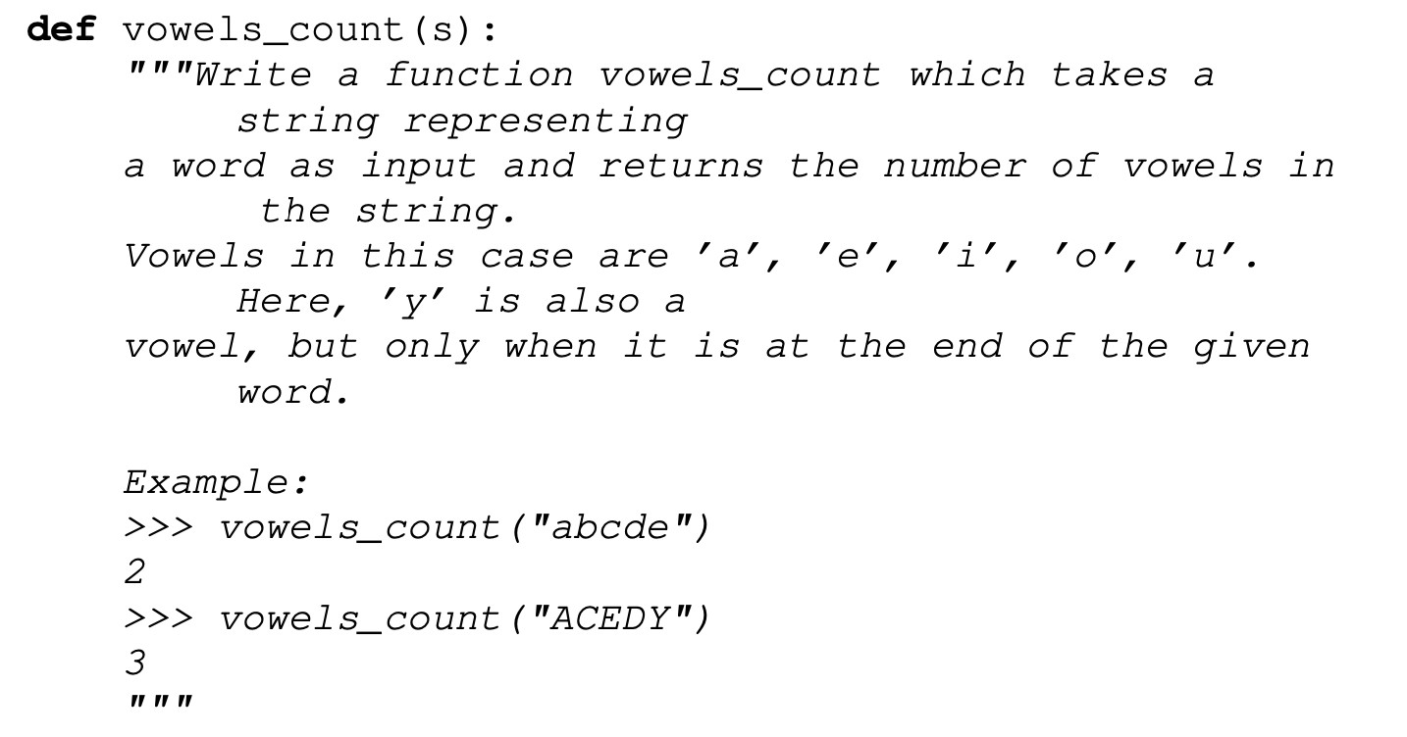

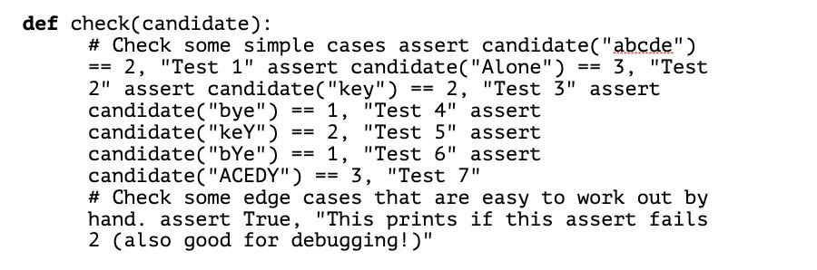
Evaluation
Format:
function signature
docstring with examples
unit-tests
Evaluating Large Language Models Trained on Code, 2021

Slide 20


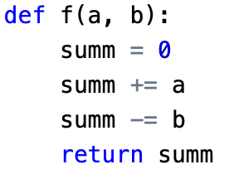
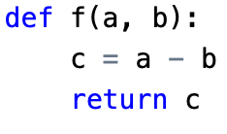

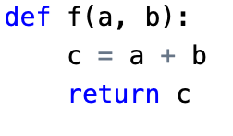
Evaluation
The traditional NLP metrics are not necessarily good for code generation.
Instead, they measure functional correctness.
Whether the generated code (ignoring its details) passes all unit tests
This is the way humans evaluate correctness of the code rather than its content.
Equivalent code
Reference code
Non-equivalent code
BLEU = 81
BLEU = 66
Evaluating Large Language Models Trained on Code, 2021

Slide 21
Evaluation
Given a prompt, generate k samples
For each, sample tokens until a stop sequence is encountered
pass@k: the probability that at least one of the top k-generated code samples for a problem passes the unit tests.
How do you compute this?
Think about it! ;-)
Evaluating Large Language Models Trained on Code, 2021

Slide 22
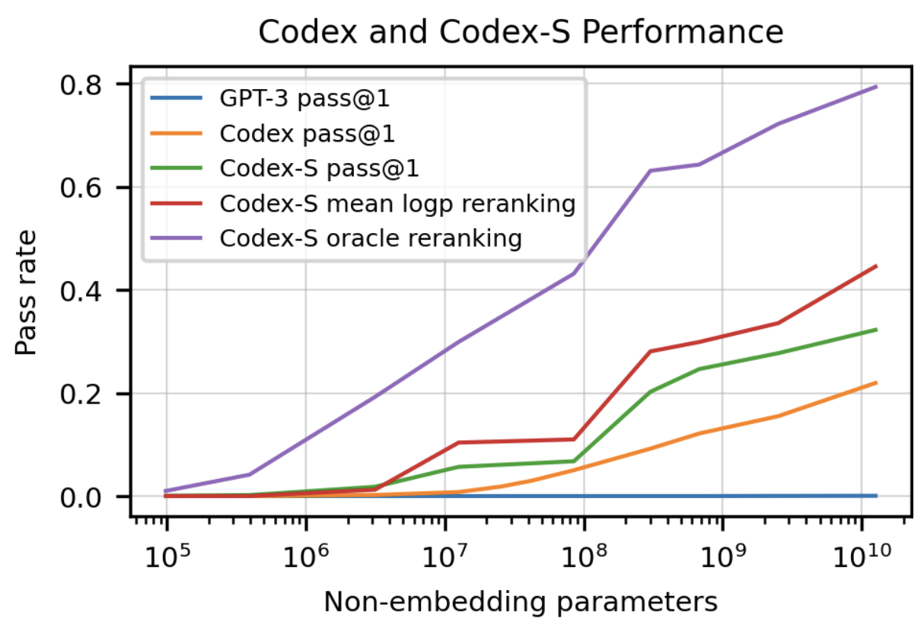
Results
Scaling improves the results
Just pre-training code (Codex) gives a major boost.
Reranking heuristics:
Generate 100 samples per problem and selecting the sample with the highest mean log-probability or by selecting the sample that passes the unit tests (oracle).
Evaluating Large Language Models Trained on Code, 2021

Slide 23
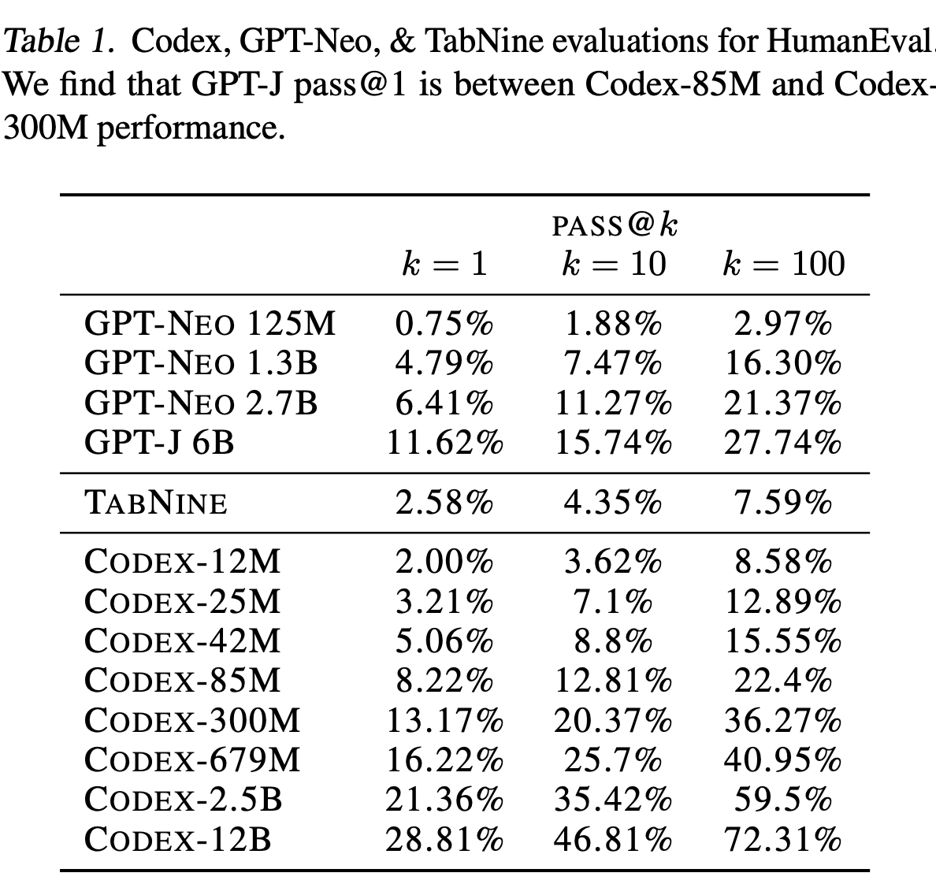
Results: w/ Open-source Models
Existing open-source models (GPT-J and GPT-Neo) know a surprising amount about code generation!!
Reason: The Pile (used for GPT-J) contains a lot of code: 8% GitHub code, along with natural language data
Evaluating Large Language Models Trained on Code, 2021

Slide 24
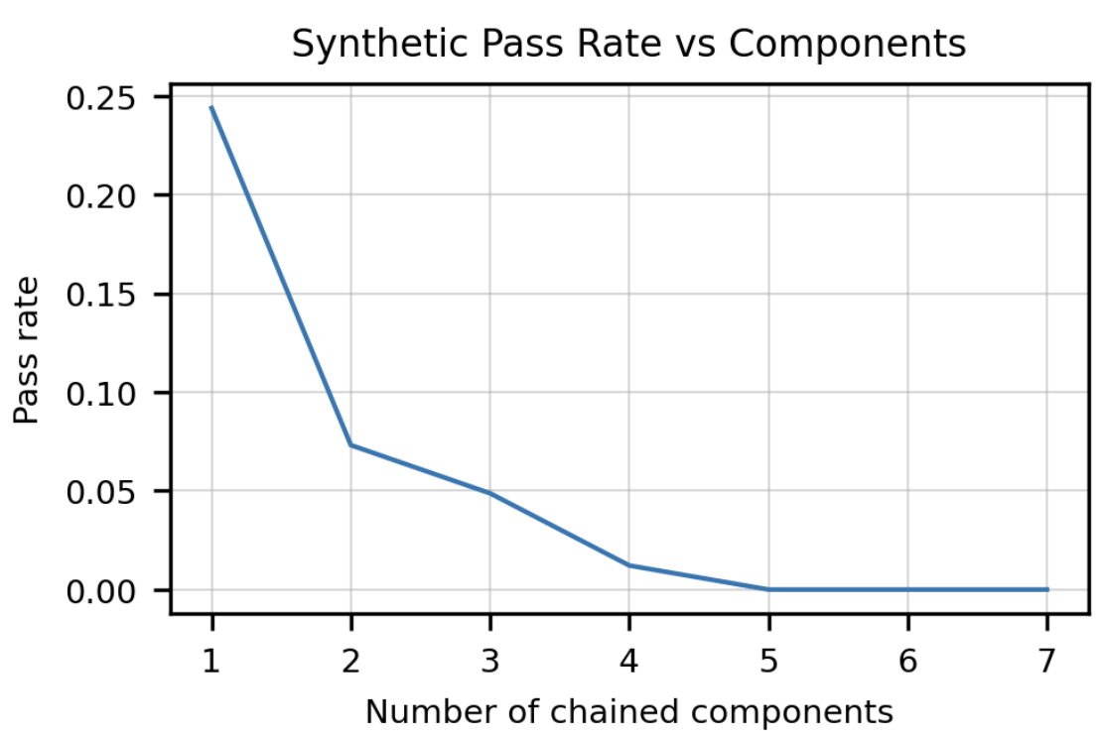
Result: Degradation with Length
The longer the inputs instructions are, the lower the model performance is.

Slide 25
Summary
Our focus: building a bridge between natural language and code.
Turns out the ideas in prior chapters go a long way!
The importance of this is more than just increasing the productivity of programmers!
In the next part, we will use this bridge to enable LMs speak to do various things!

Slide 26
Connecting Language to Actions/Tools

Slide 27

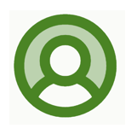
Leverage LLMs for Real-World Tasks
def grab(obj): # grab the target object ...
def move_ahead(dist): # move ahead by dist ...
def put(obj, loc): # put the object at loc ...
LLM
Available Actions/APIS
Put this book on the table.
def put_book(book, shelf): # grab the book grab(book) # move ahead by 1 meter move_ahead(1) # put the book at the shelf put(book, shelf)
Policies/Programs

Slide 28
Leverage LLMs for Real-World Tasks
User Interaction:
Planning:
Execution:
Tool/Action1
Robot Actions
LLM
Tool/Action 2
App Tools (e.g., map, weather)
Make me a cup of coffee
Plan a 2-day trip to DC
Buy my favorite snacks
def make_coffe() ...
def plan_route(): ...
def buy_snacks():
...
Tool/Action 3
Web Navigation APIs (e.g., click, type, select)

Slide 29
LLMs as Backbones for Planners
Rich parametric knowledge about commonsense and procedures
Impressive capabilities of zero-shot/few-shot code generation

Slide 30
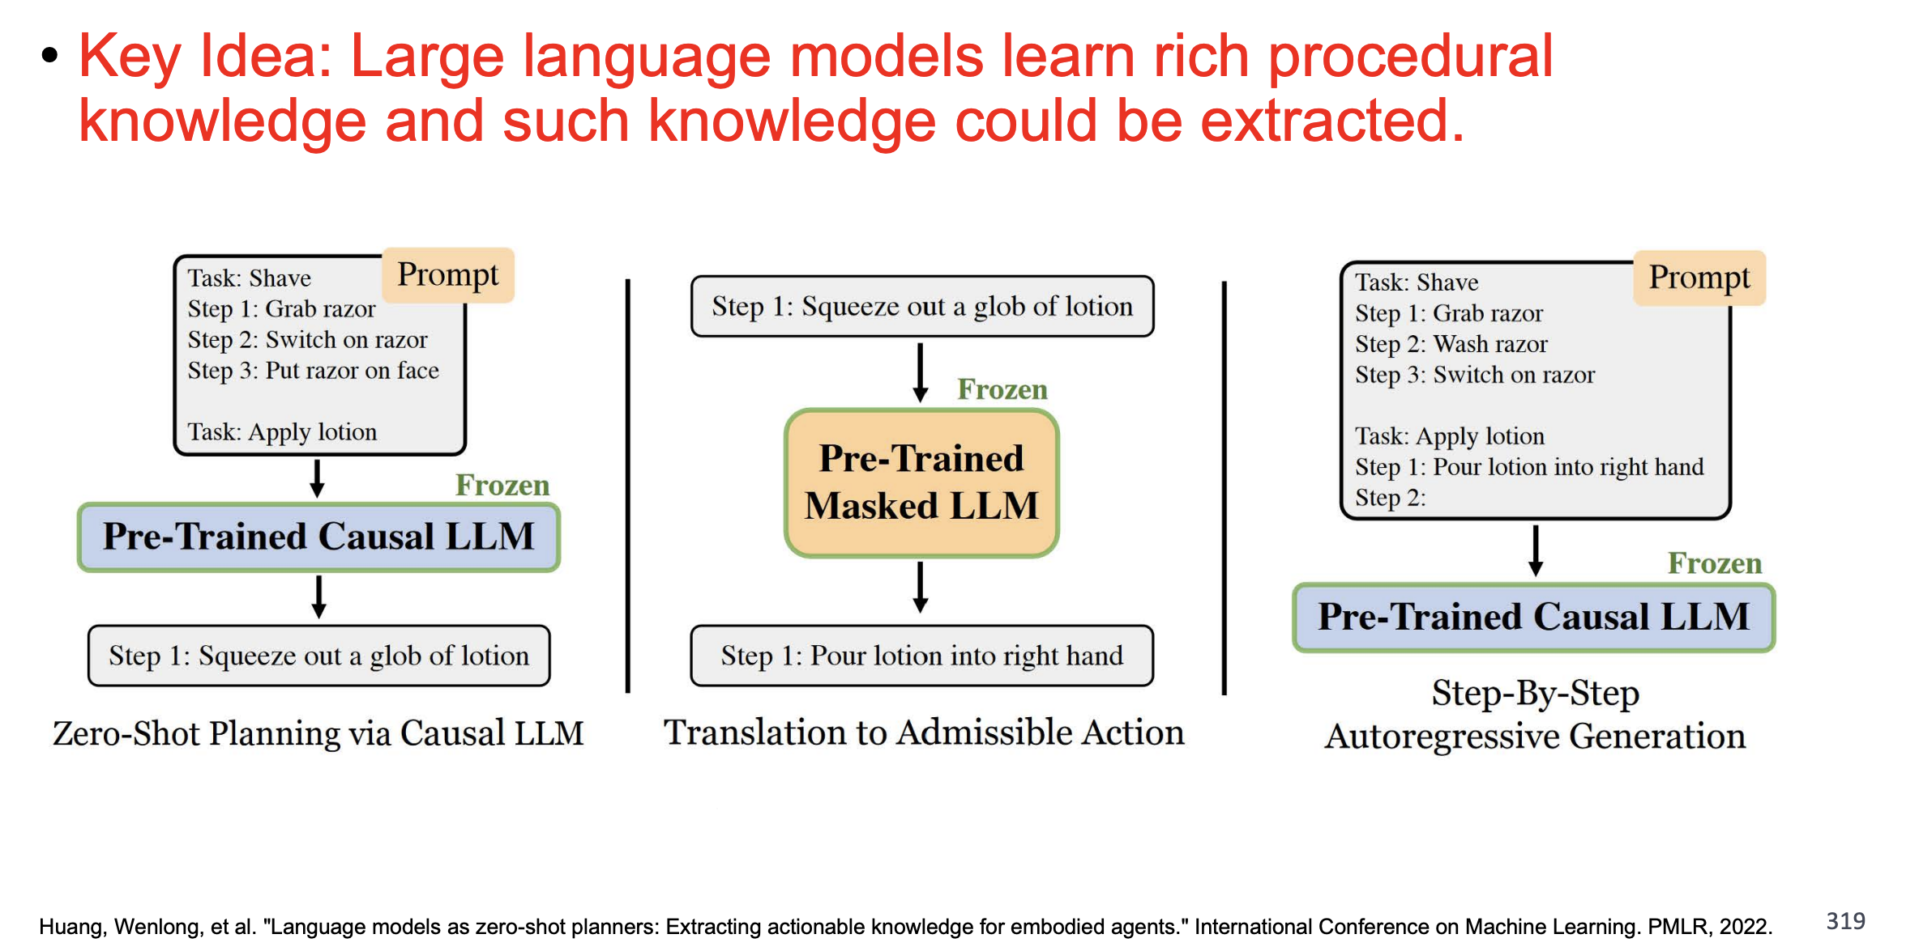
LMs as Planners: Procedural and Commonsense Knowledge

Slide 31
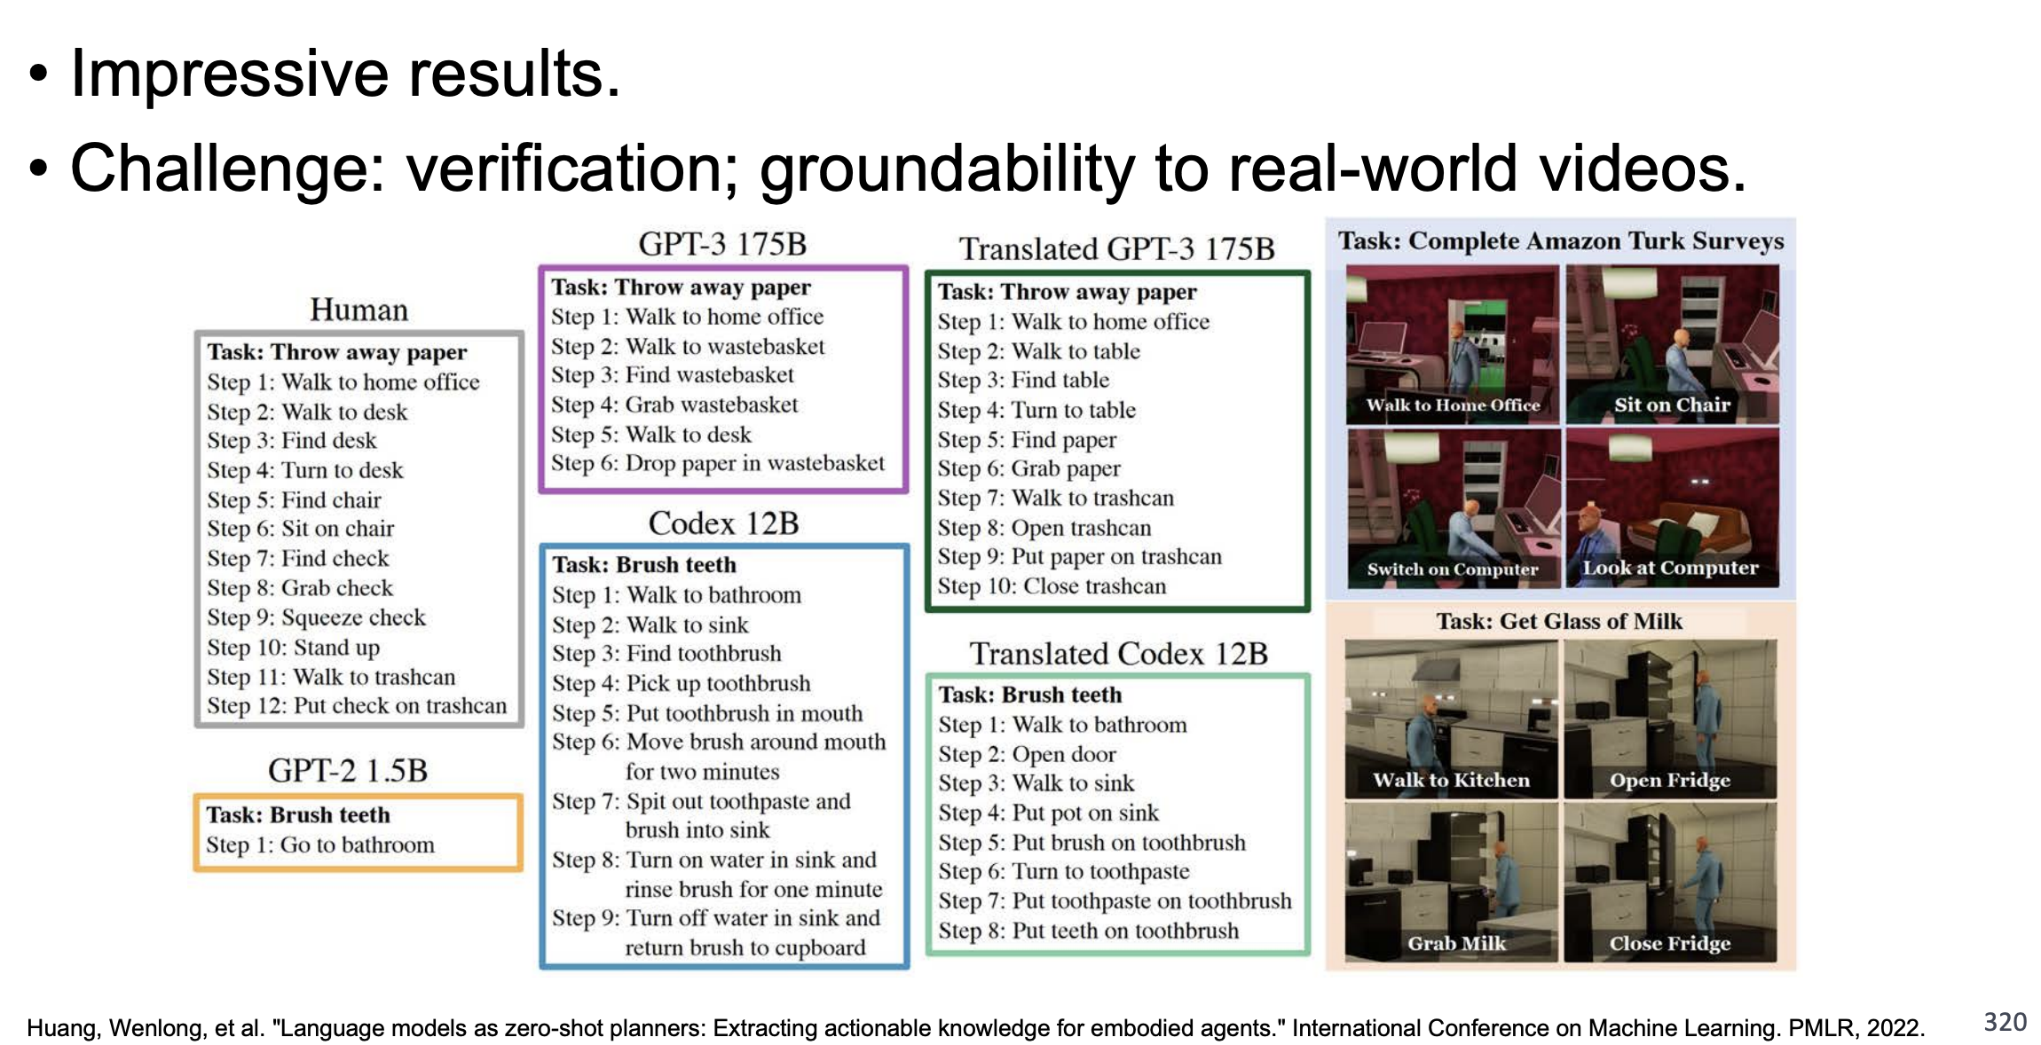
LMs as Planners: Procedural and Commonsense Knowledge

Slide 32
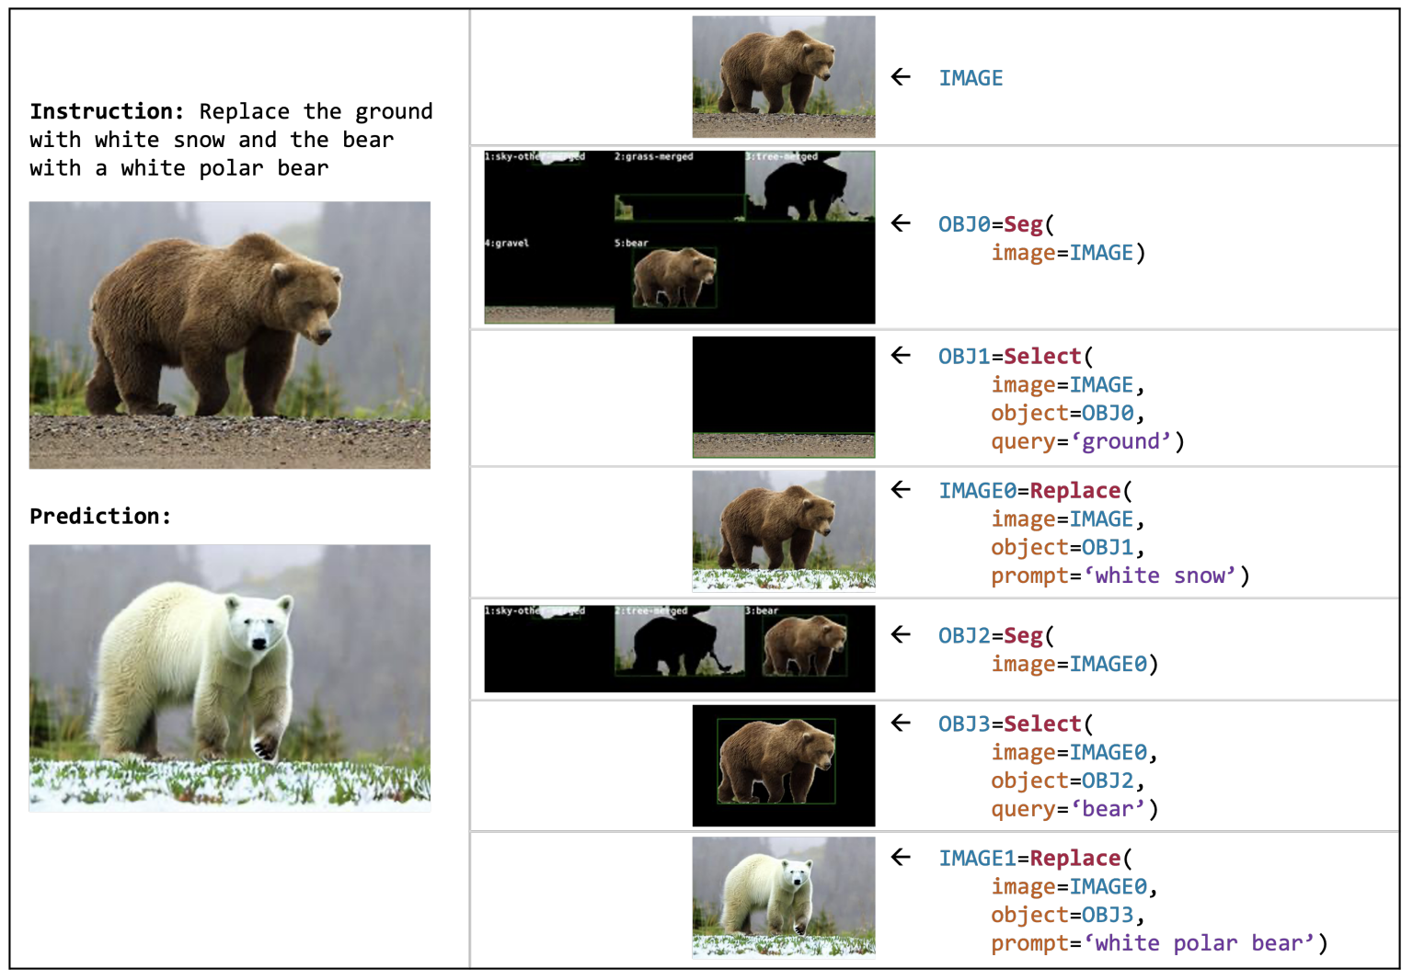
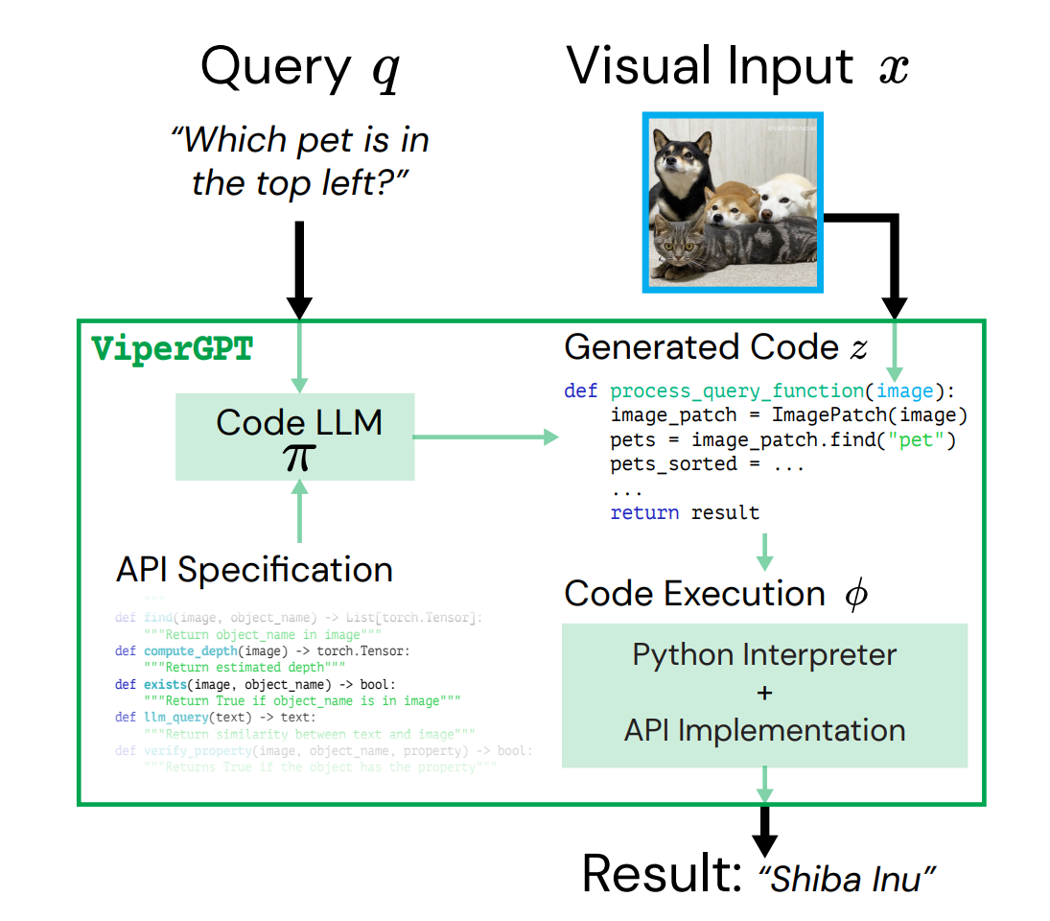
LLM as Planners: Composing Tools via Code Generation
Visual Programming: Compositional visual reasoning without training
ViperGPT: Visual Inference via Python Execution for Reasoning

Slide 33
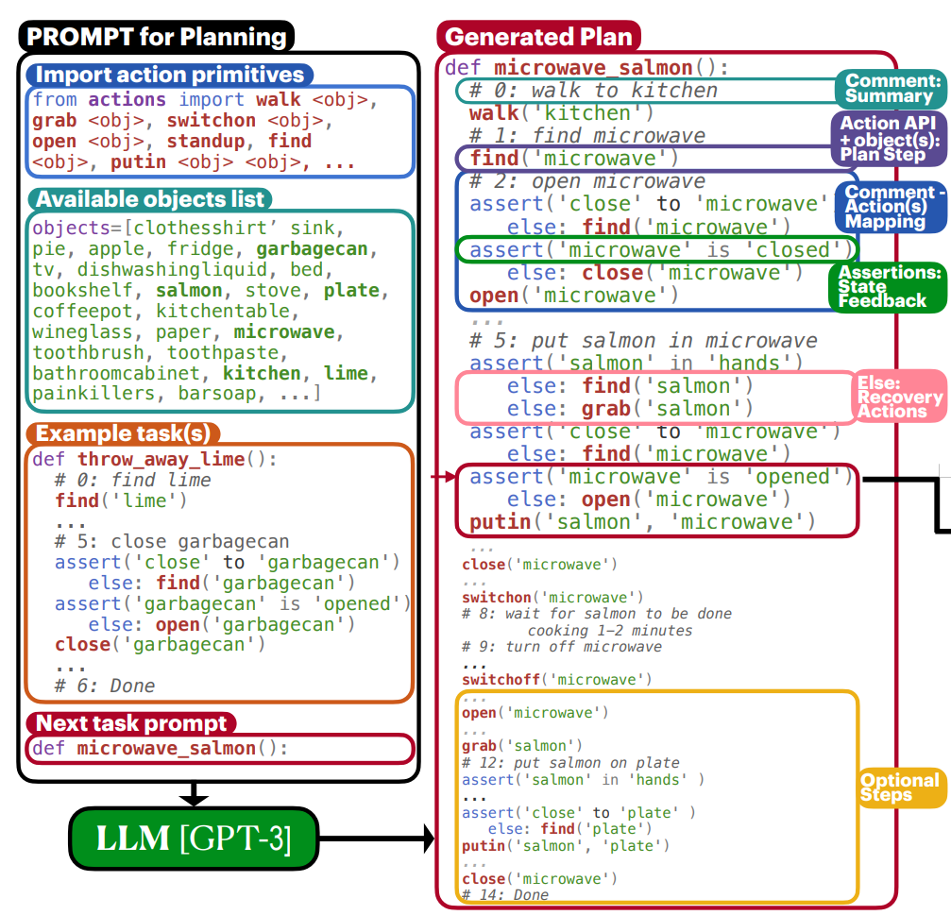
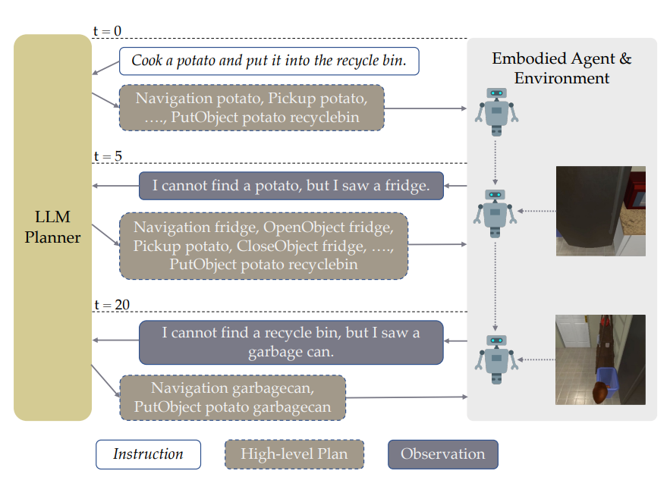
Application: Embodied Planning
Generating Situated Robot Task Plans using LLMs
Few-Shot Grounded Planning for Embodied Agents with LLMs

Slide 34
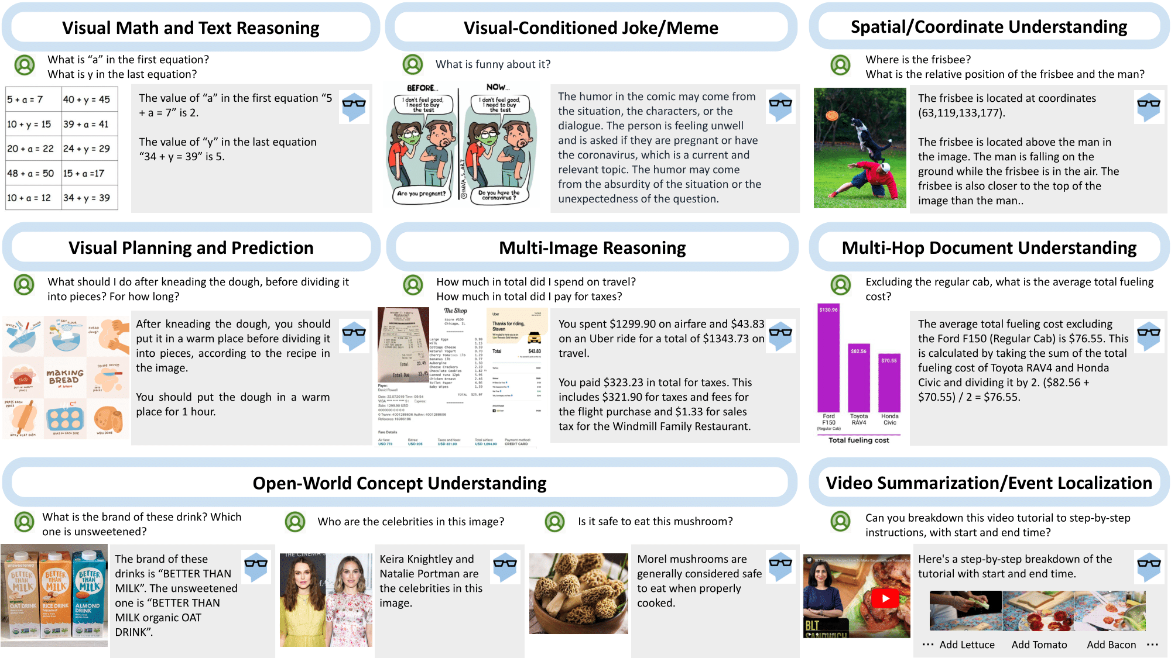
Application: Vision-Language Agents
Few-Shot Grounded Planning for Embodied Agents with LLMs
MM-ReAct: Connecting LLM to Vision Experts

Slide 35
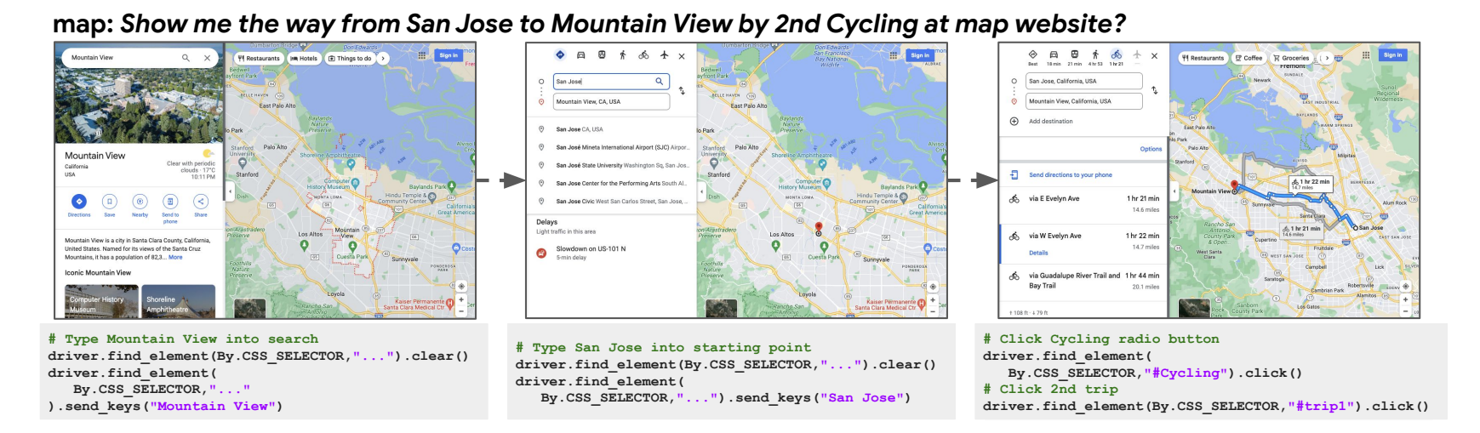
Application: Web Agents

Slide 36
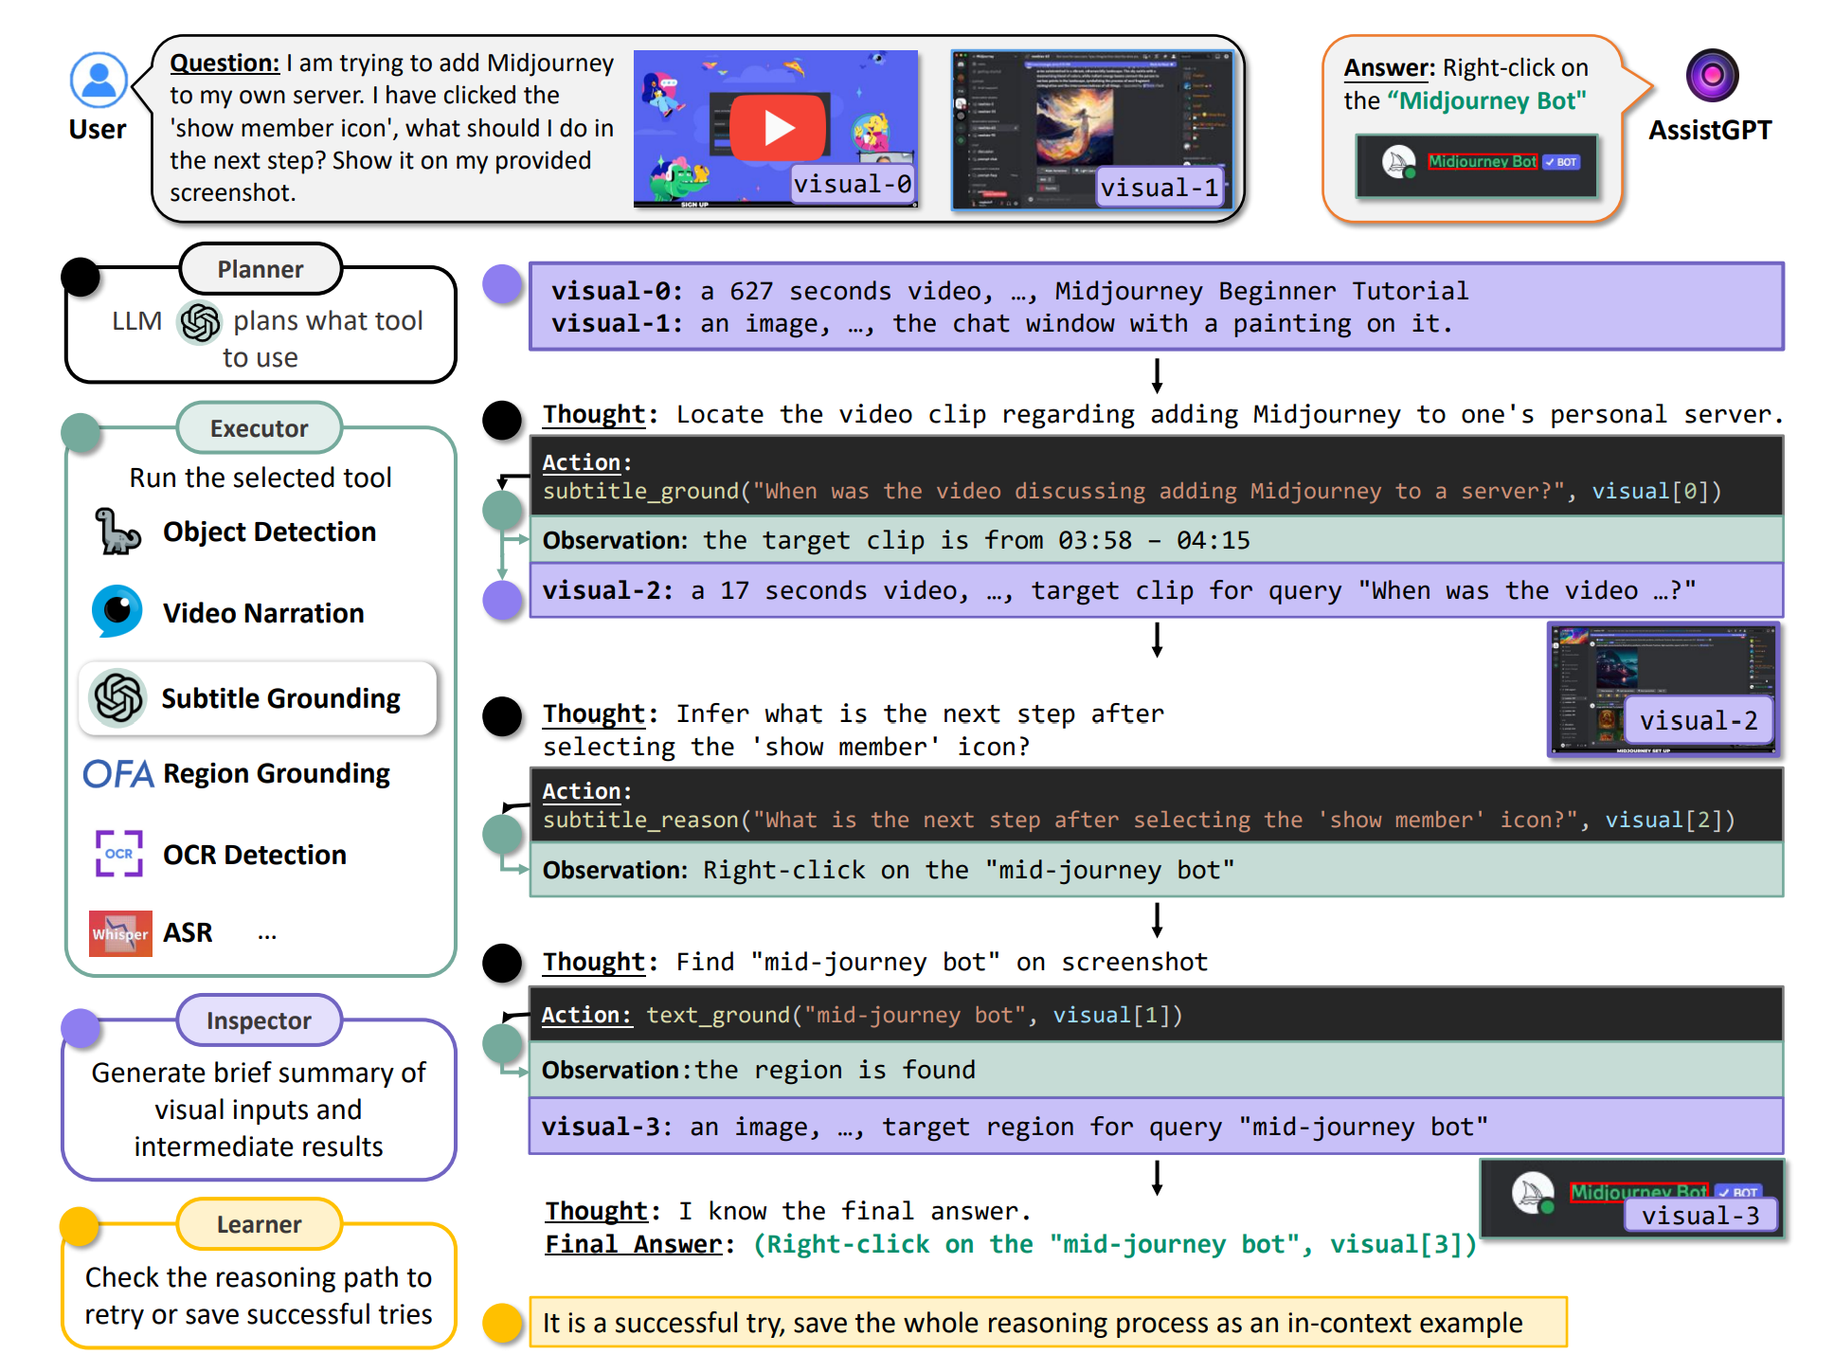
Tool Using with Self-Assessment
AssistGPT: A General Multi-modal Assistant that can Plan, Execute, Inspect, and Learn

Slide 37
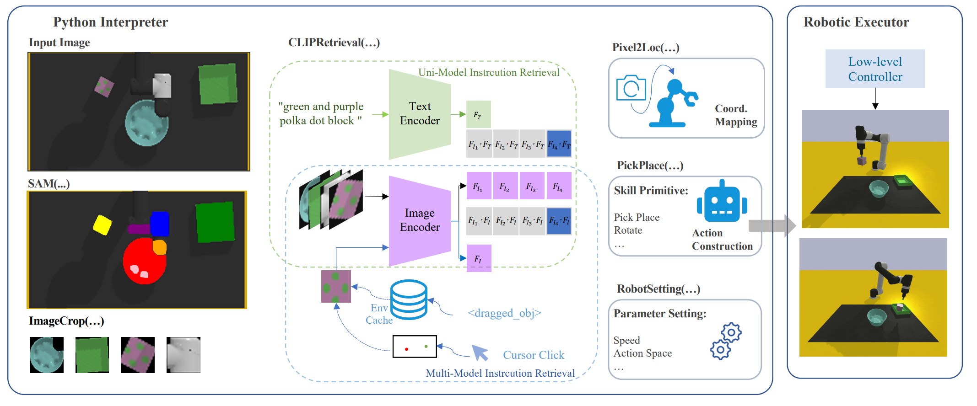
Applications : Robotics
Instruct2Act: Mapping Multi-modality Instructions to Robotic Actions with Large Language Model

Slide 38
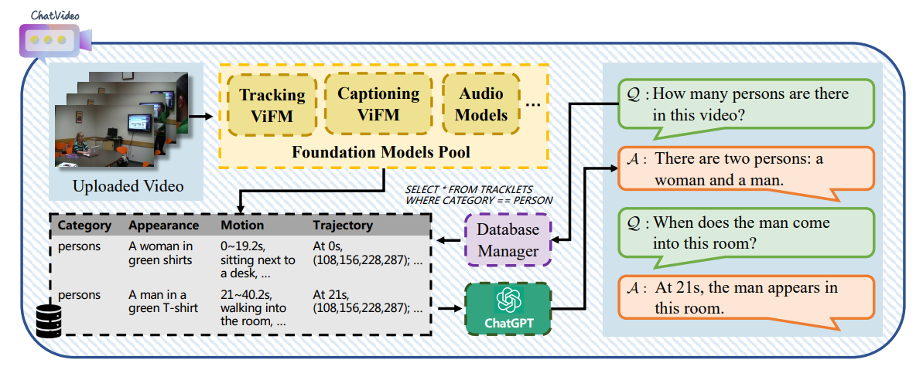
Applications: Multi-Channel Video Understanding
ChatVideo: A Tracklet-centric Multimodal and Versatile Video Understanding System

Slide 39
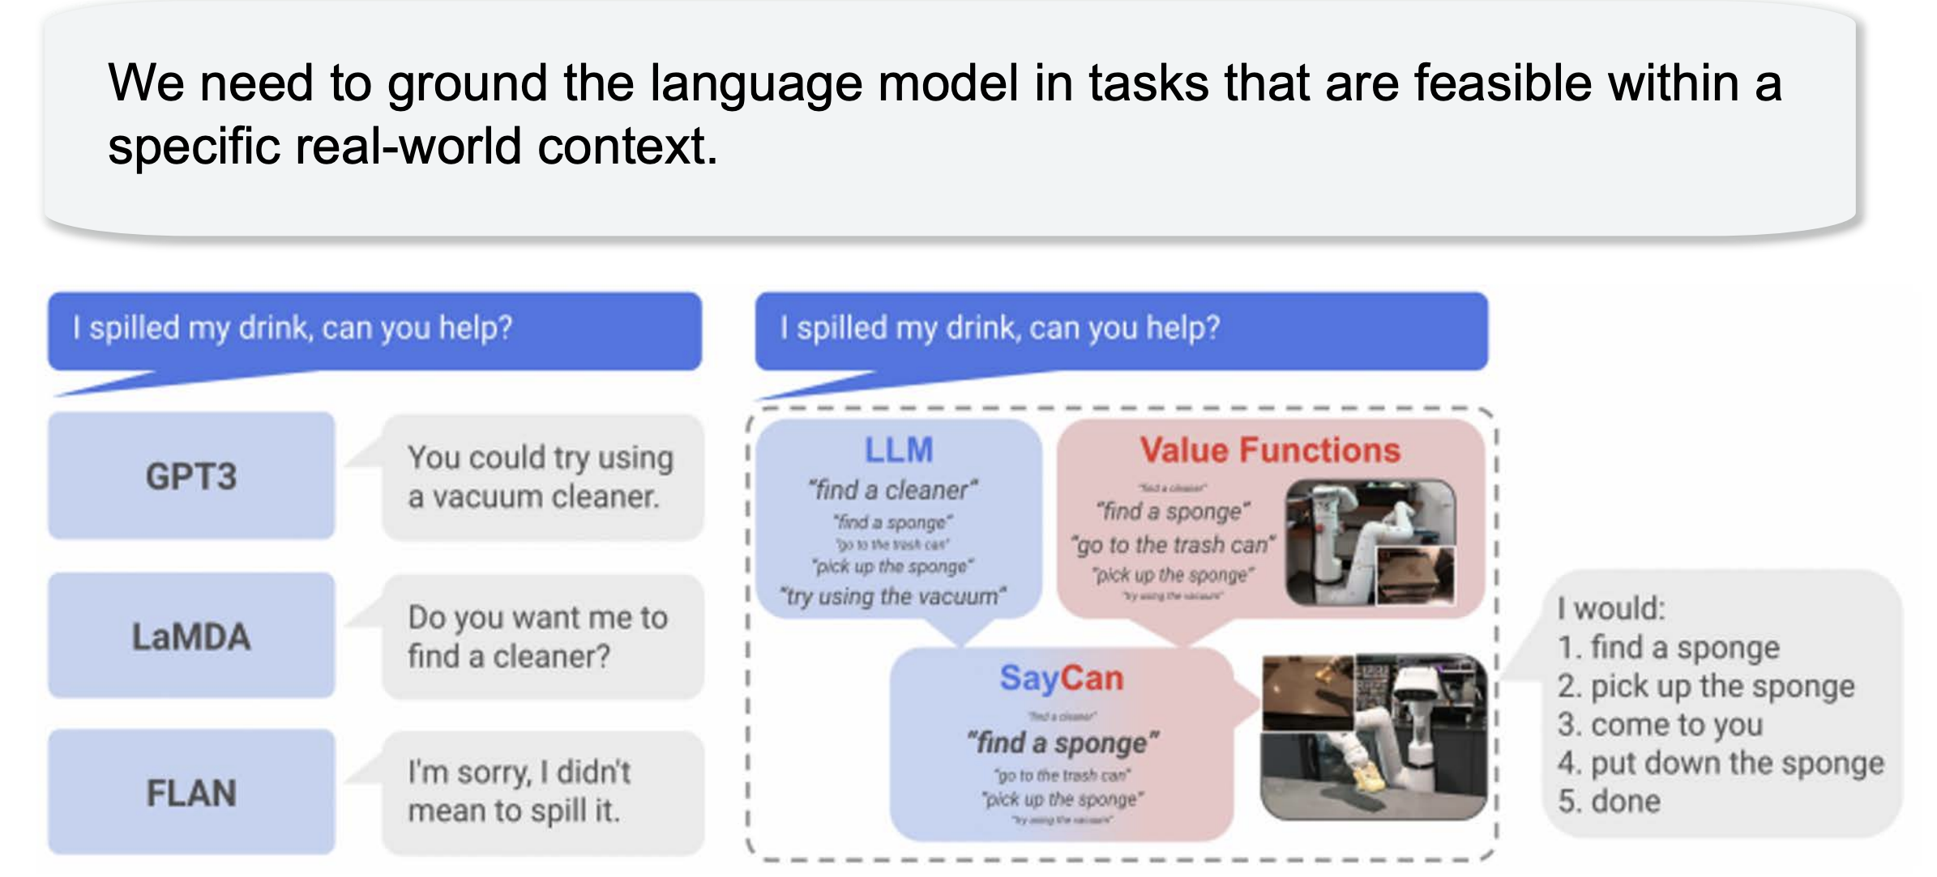
SayCan: Grounding Language in Affordances

Slide 40
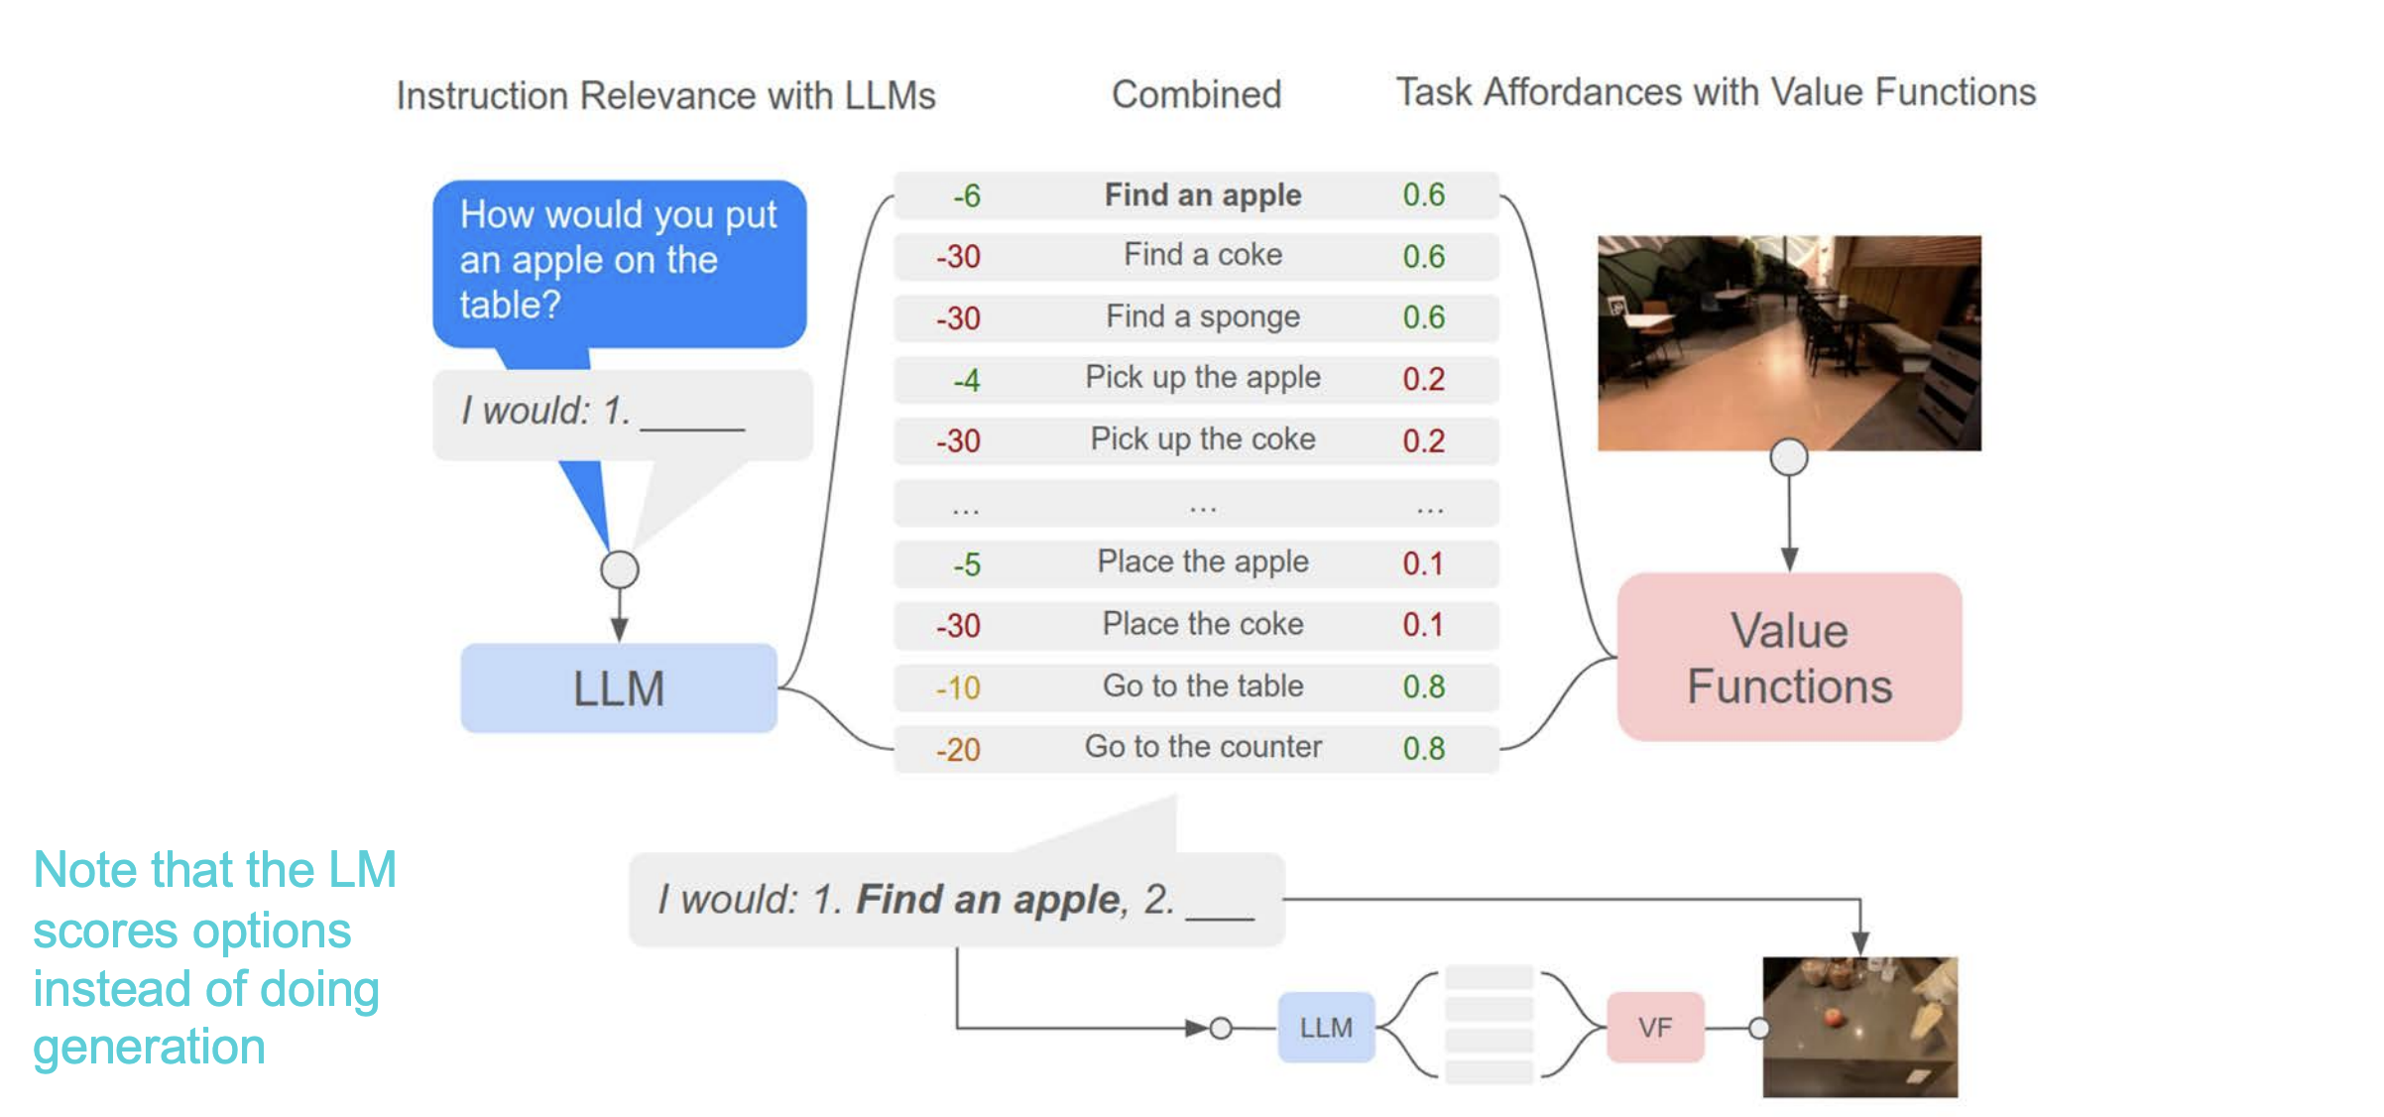
SayCan: Grounding Language in Affordances

Slide 41
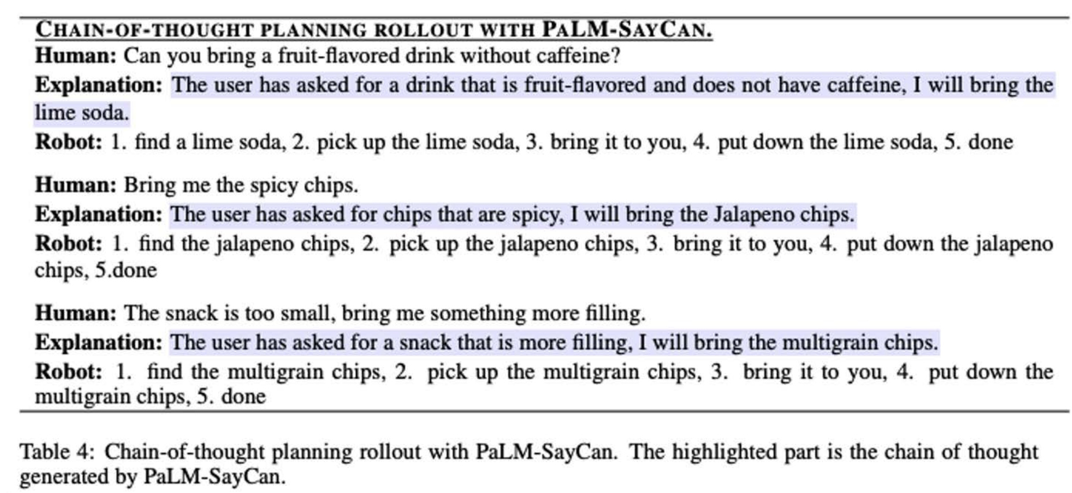
SayCan + Chain-of-Thought

Slide 42
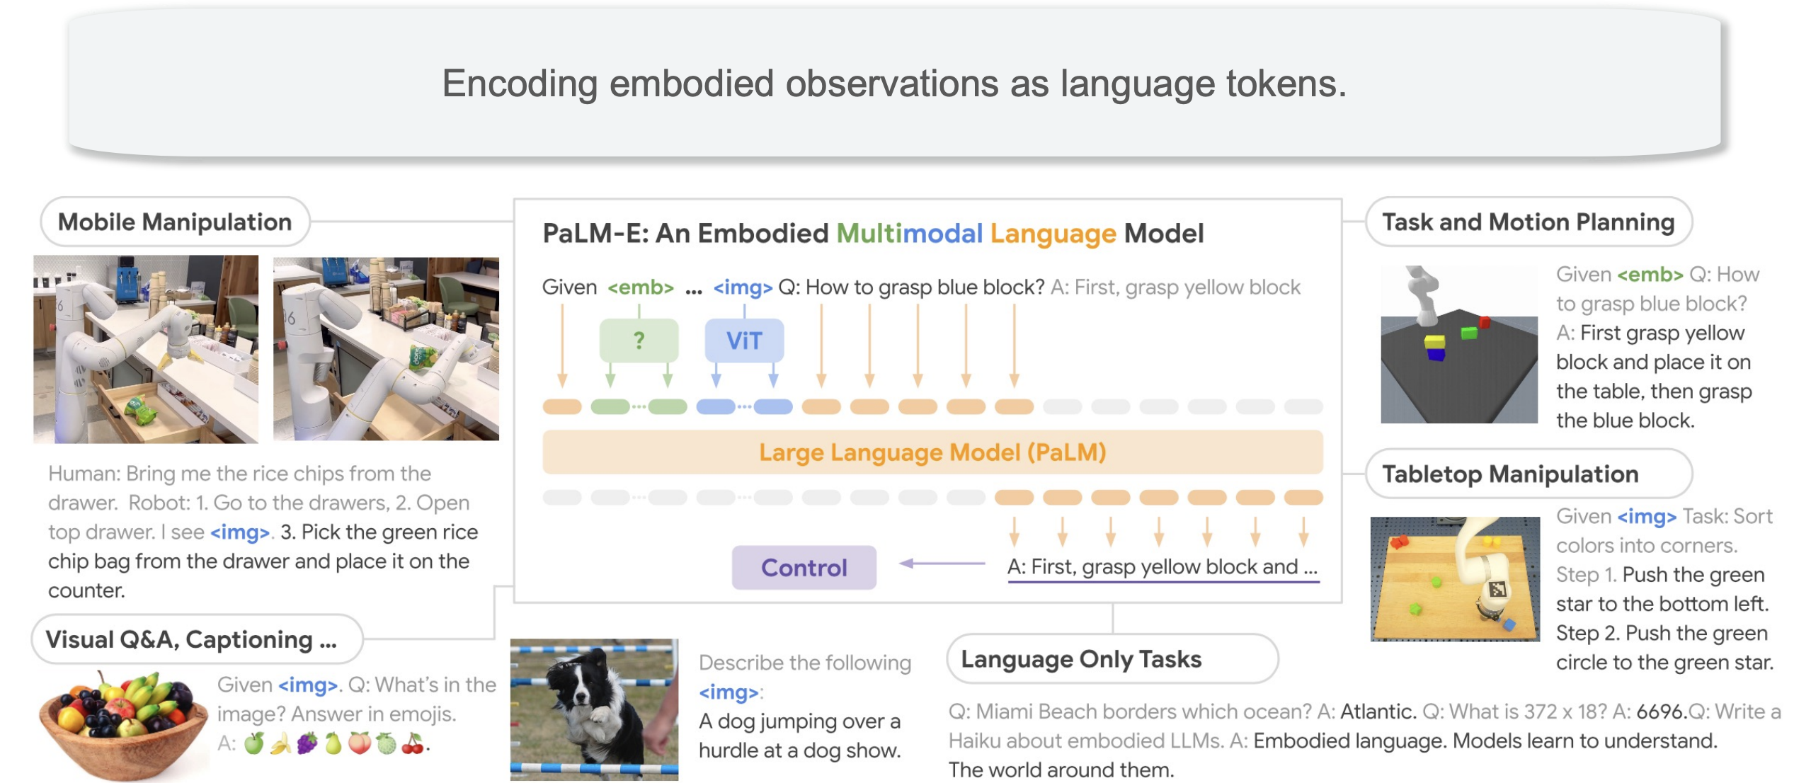
PaLM-E: Embodied Multimodal LM

Slide 43
Planning with Environment Feedback

Slide 44
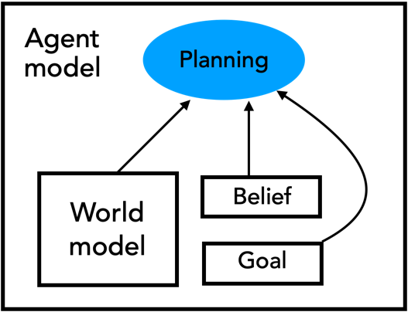
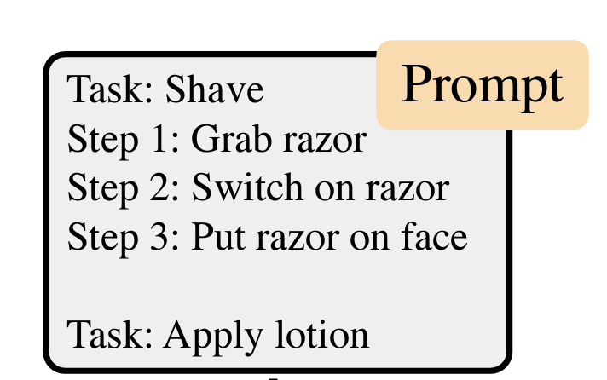
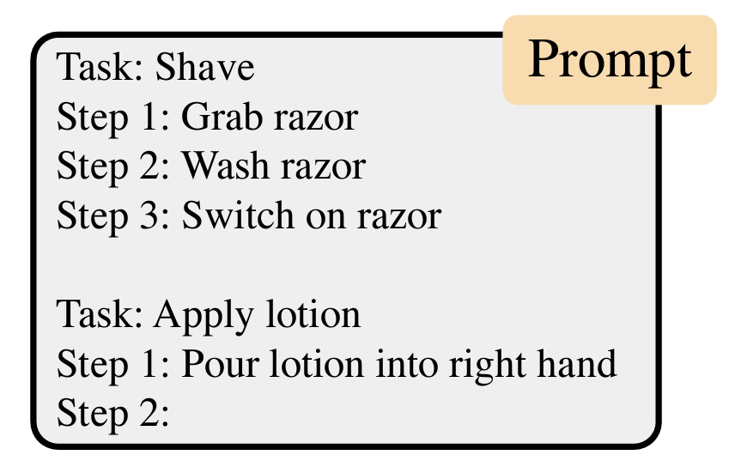
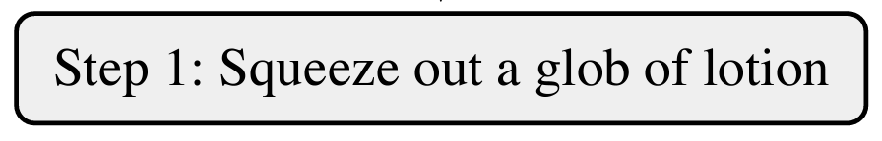
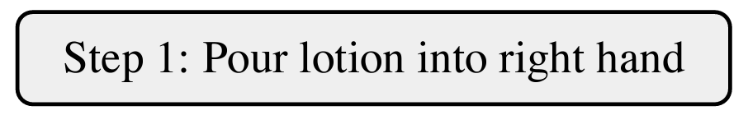
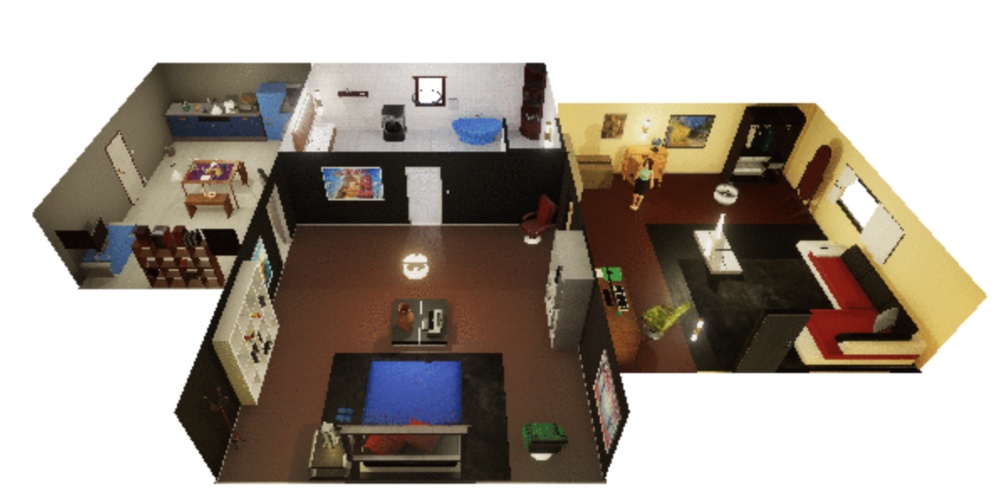
Language models as (autoregressive) planners
All possible actions
in the environment
LLM
LLM
…
Huang et al. (2022)
"Language Models meet World Models" Zhiting Hu and Tianmin Shu, 2023

Slide 45
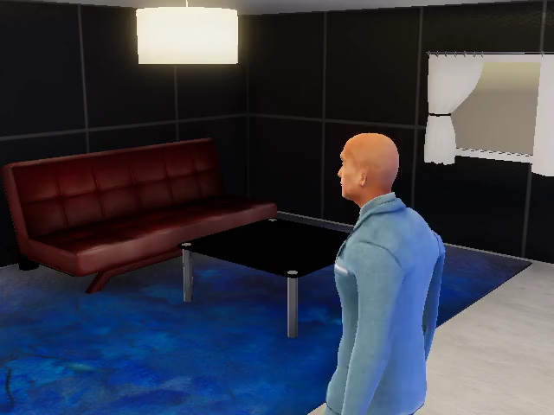

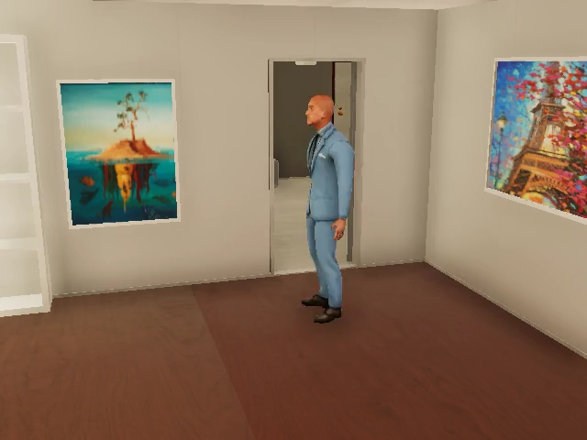
Language models as (autoregressive) planners
Empty Dishwasher
Organize Closet
Huang et al. (2022)
"Language Models meet World Models" Zhiting Hu and Tianmin Shu, 2023

Slide 46
Language models as (autoregressive) planners
?
All possible actions
in the environment
LLM
LLM
?
…
No environment feedback
Huang et al. (2022)
"Language Models meet World Models" Zhiting Hu and Tianmin Shu, 2023

Slide 47
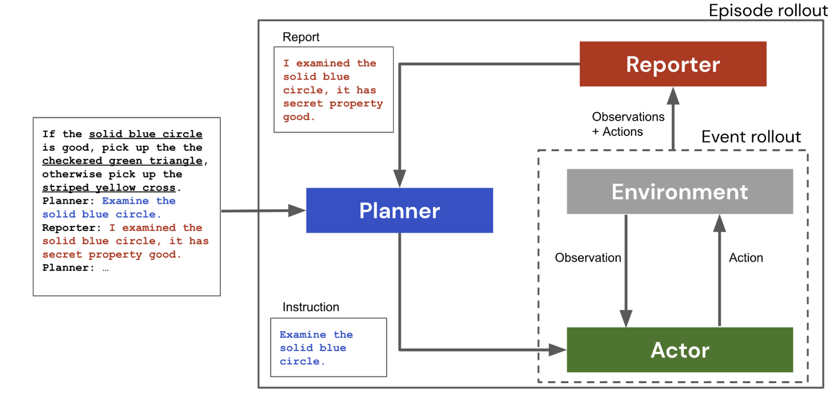
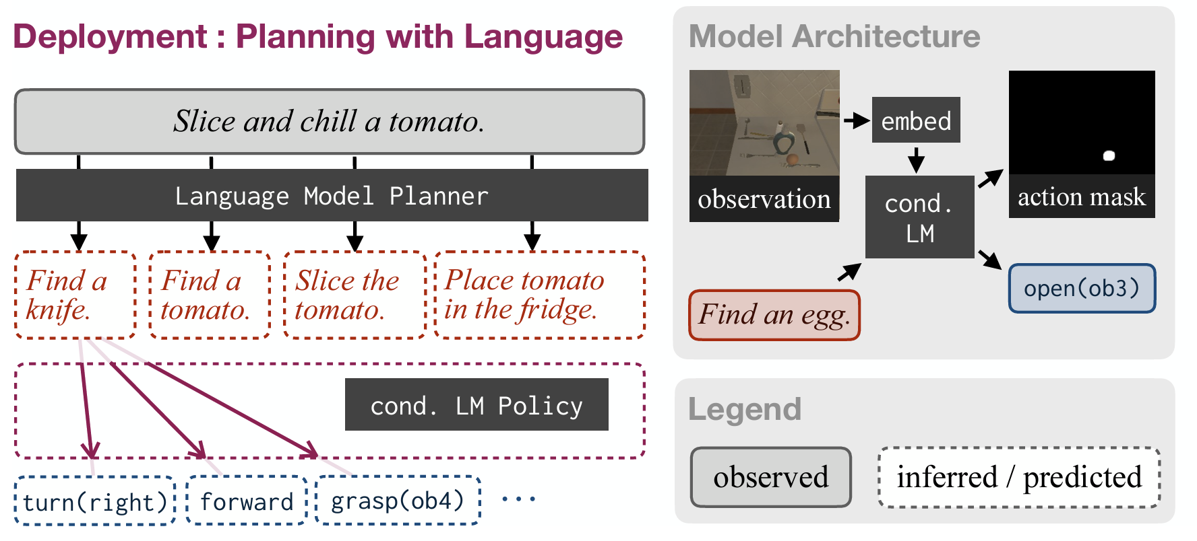
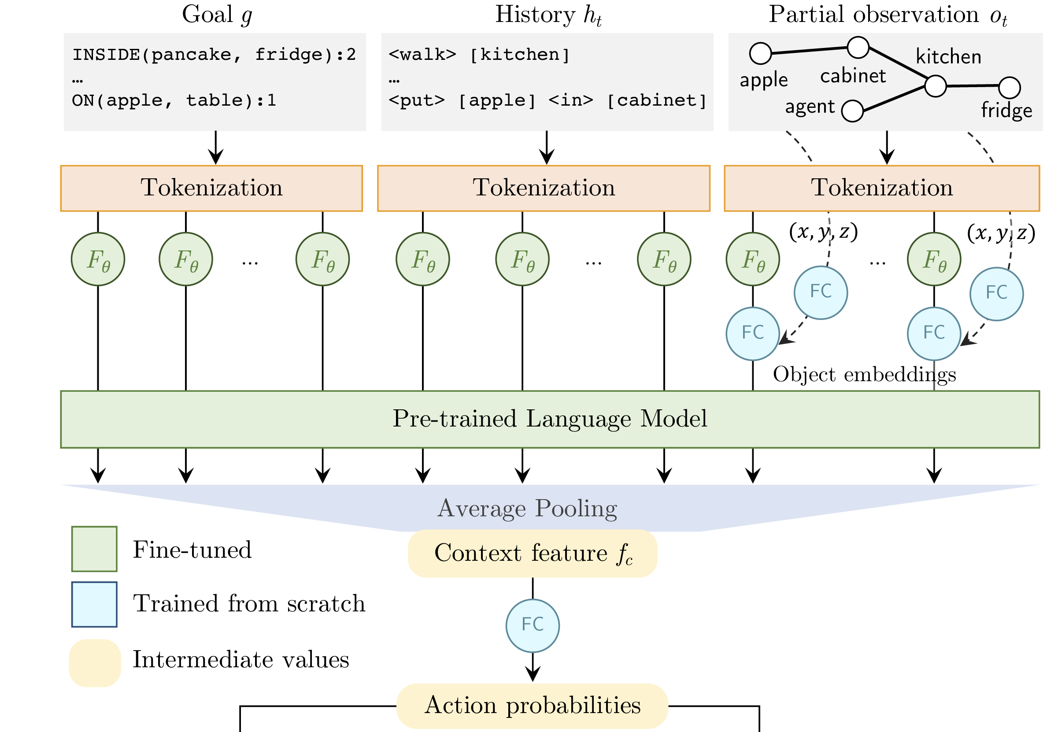
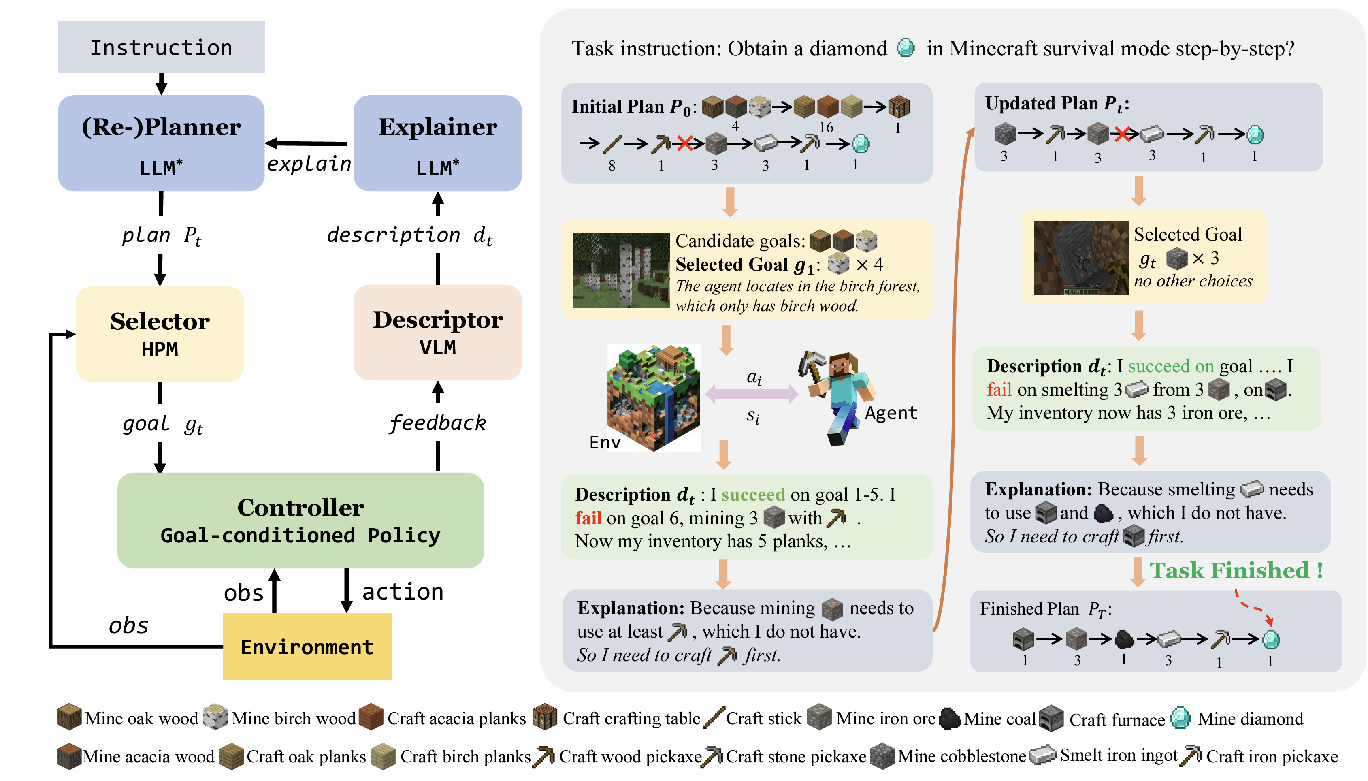
Interactive planner
Sharma et al. (2021)
Dasgupta et al. (2022)
Li et al. (2022)
Wang et al. (2023)
"Language Models meet World Models" Zhiting Hu and Tianmin Shu, 2023

Slide 48
Interactive planner
Description (e.g., scene graphs)
Observation
History: actions taken so far
Progress: I have done xxx
Failures: I couldn’t find xxx
…
LLM
Reflection
Memory
Goal
Feature / high-level plans
“Go to kitchen”
Policy
Raw obs. (e.g., image)
“Turn left”
Action
"Language Models meet World Models" Zhiting Hu and Tianmin Shu, 2023

Slide 49
Sustained Embodied Reasoning in Rich Environments

Slide 50

Limits in LLMs
Social reasoning: understanding humans
Does this person need help?
"Language Models meet World Models" Zhiting Hu and Tianmin Shu, 2023

Slide 51
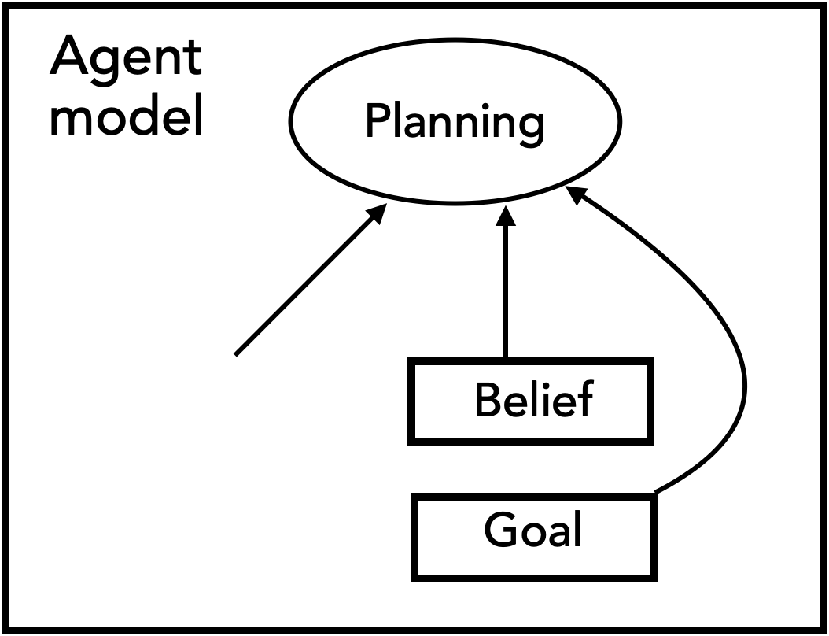

World models and agent models
"Language Models meet World Models" Zhiting Hu and Tianmin Shu, 2023

Slide 52
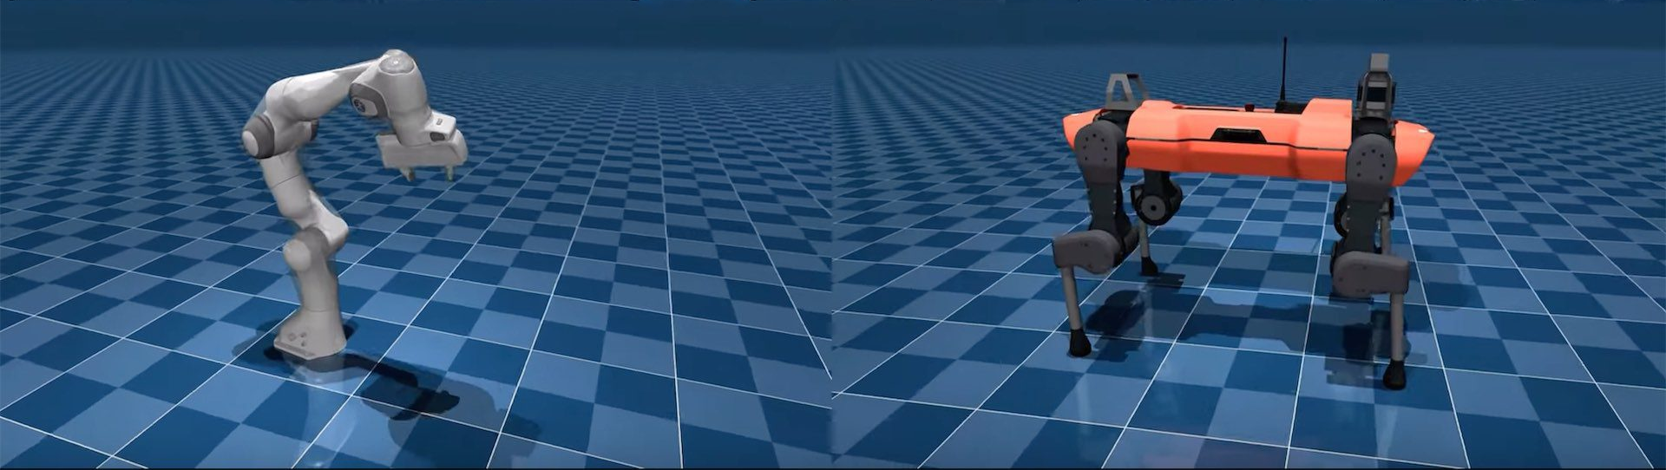
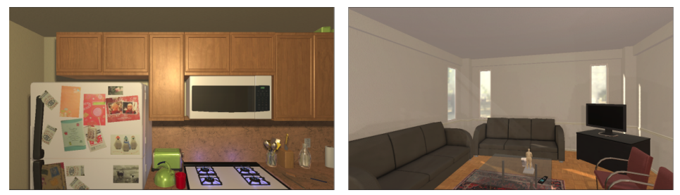
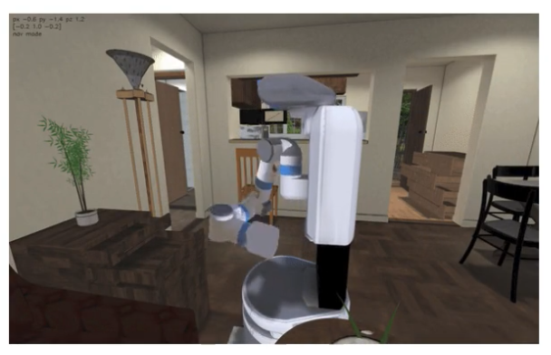


Simulators as world models
Physics engines / embodied simulators
MuJoCo
AI2-THOR
Todorov et al. (2012)
Kolve et al. (2017)
iGibson 2.0
Habitat 2.0
ThreeDWorld
Li et al. (2021)
Szot et al. (2021)
Gan et al. (2020)
"Language Models meet World Models" Zhiting Hu and Tianmin Shu, 2023

Slide 53


Simulators as world models
Embodied simulators + synthetic humans
Habitat 3.0
VirtualHome 2.0
Puig et al. (2021)
Puig et al. (2023)
"Language Models meet World Models" Zhiting Hu and Tianmin Shu, 2023

Slide 54

Video prediction for robot planning
Yang et al. (2023)
"Language Models meet World Models" Zhiting Hu and Tianmin Shu, 2023

Slide 55

"Language Models meet World Models" Zhiting Hu and Tianmin Shu, 2023

Slide 56

Humans represent agents differently from objects
Heider & Simmel (1944)

Slide 57

Humans represent agents differently from objects
Strengths
strong, weak
Goals
helping, hurting, escaping
Relationships
friends, enemies
Moral judgment
good guy, bully
(size / velocity / angle…)
A big triangle moves back and forth, while a small triangle and a small circle rotate 360°…
"Language Models meet World Models" Zhiting Hu and Tianmin Shu, 2023

Slide 58


Level-0 agent models for embodied tasks
Goal
Current state
Simulate plans via world model
Choose the best plan
"Language Models meet World Models" Zhiting Hu and Tianmin Shu, 2023

Slide 59


Level-1 agent models for social reasoning
Goal: Office or coffee shop?
An observer
"Language Models meet World Models" Zhiting Hu and Tianmin Shu, 2023

Slide 60


Level-1 agent models for social reasoning
Theory of Mind: mapping actions to mental state
"Language Models meet World Models" Zhiting Hu and Tianmin Shu, 2023

Slide 61
Summary
"Language Models meet World Models" Zhiting Hu and Tianmin Shu, 2023

Slide 62
Summary
"Language Models meet World Models" Zhiting Hu and Tianmin Shu, 2023

Slide 63
Another issue is interaction with more then one agents

Slide 64

Multi-agent planning and communication
Multi-agent collaboration
Mandi et al. (2023)
"Language Models meet World Models" Zhiting Hu and Tianmin Shu, 2023

Slide 65

Multi-agent planning and communication
Human-AI cooperation
Zhang et al. (2023)
"Language Models meet World Models" Zhiting Hu and Tianmin Shu, 2023

Slide 66

Multi-agent planning and communication
Social interaction between multiple simulated agents
Park et al. (2023)
"Language Models meet World Models" Zhiting Hu and Tianmin Shu, 2023

Slide 67
Multi-agent planning and communication
Social interaction between multiple simulated agents
Persona
Social relationships with other agents
John Lin is a pharmacy shopkeeper at the Willow Market and Pharmacy who loves to help people.
…
John Lin is living with his wife, Mei Lin, who is a college professor, ands on, Eddy Lin, who is a student studying music theory
Park et al. (2023)
"Language Models meet World Models" Zhiting Hu and Tianmin Shu, 2023

Slide 68


Multi-agent planning and communication
A day in the life (persona)
Conversation (social relation)
Social interaction between multiple simulated agents
Park et al. (2023)
"Language Models meet World Models" Zhiting Hu and Tianmin Shu, 2023

Slide 69
Summary
Model-based reasoning
Data-efficient
Generalizes to new scenarios well
Traditionally, world models and agent models are all domain specific
Can we leverage the open-endedness of LMs to construct world and agent models?
Language models as backend
"Language Models meet World Models" Zhiting Hu and Tianmin Shu, 2023

Slide 70
Summary
Language models as the backend for world models and agent models, supporting model-based reasoning
Conventional paradigms
LM backend: more general and open-ended
"Language Models meet World Models" Zhiting Hu and Tianmin Shu, 2023

Slide 71
Summary
Language models as the backend for world models and agent models, supporting model-based reasoning
While language alone is not sufficient for many tasks, language models can be connected with models operating on other modalities to achieve multimodal capacity
There is still a need for manually crafted components (such as belief / memory modules) or conventional methods (such as classical planning)
Enhancing the language model backend
Multimodality?
Single-model or modular design?
…
Questions?
"Language Models meet World Models" Zhiting Hu and Tianmin Shu, 2023

Slide 72
Envisioning the future
More modalities — combinations of video (2D, 3D), text, code, etc.
Large models and more efficient scaling
More breath — more data and more types of data
Interaction with physical world — models with hands and actuators
Better personalization — these agents should serve your 🫵 needs
Better human-machine teaming
CoPilot for coding
CoPilot for writing
….
CoPilot for life!!!

Slide 73
https://sites.google.com/princeton.edu/cos597f

